Slide 1
GRADING RUBRIC
Worksheet: Cell Test Review
HONORS BIOLOGY

Slide 2
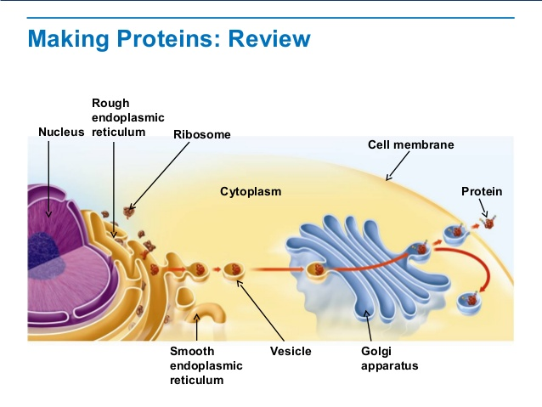
1. What cell organelles/structures are involved with protein production, packaging, transporting, and excretion from the cell?
Nucleus → rough endoplasmic reticulum → Golgi apparatus → vesicle → cell membrane

Slide 3
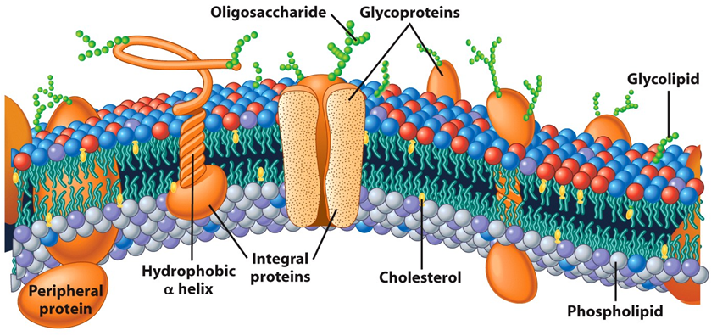
2. Why is the cell membrane often described as a “mosaic”? (What is it made up of)
Because it is made up from a mixture (mosaic) of several types of organic compounds and because the phospholipids fatty acids are unsaturated, the membrane remains flexible

Slide 4
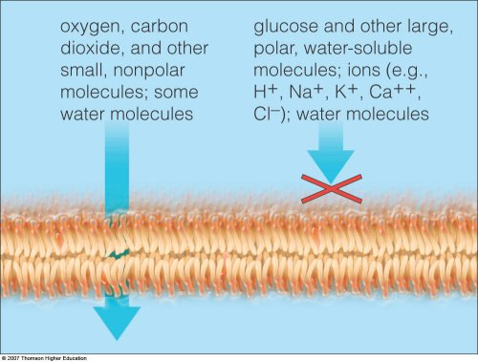
3. Why is the cell membrane referred to as “semipermeable” or “selectively permeable”?
Because it allows somethings to pass and not others. (based on size, polarity, and concentration gradient)

Slide 5
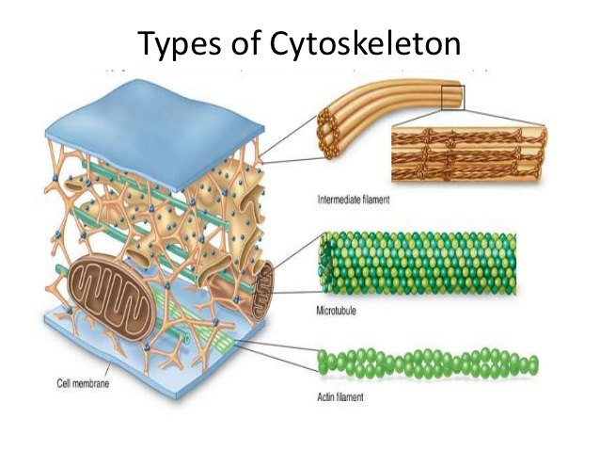
4. Name 3 important functions of the microtubules
Makes up portion of cytoskeleton
Provides “highway” for motor proteins to transport vesicles to destinations in the cell or for export
Makes up cilia and flagella
Helps in cell division (pulls apart chromosomes)

Slide 6
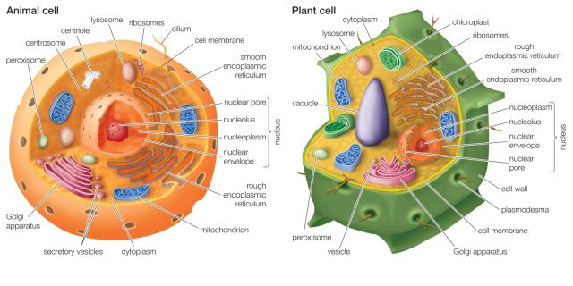
5. What organelles are found in animal cells but not in plant cells?
Centromere/centrioles
Lysosomes

Slide 7
6. What organelles are found in plant cells but not animal cells?
Cell wall
Central vacuole
chloroplasts

Slide 8
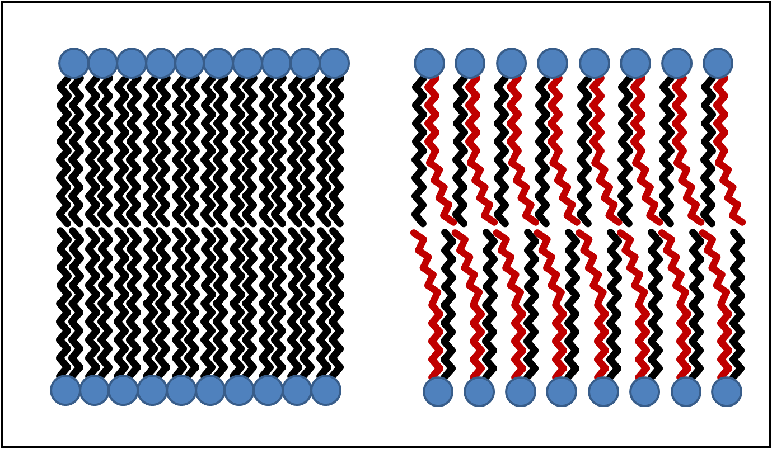
7. Why is the significance of having unsaturated fats instead of saturated fats making up the cell membrane?
The kinks in the tails due to the unsaturated fats keep the membrane more flexible and “loose” to allow passage of small molecules

Slide 9
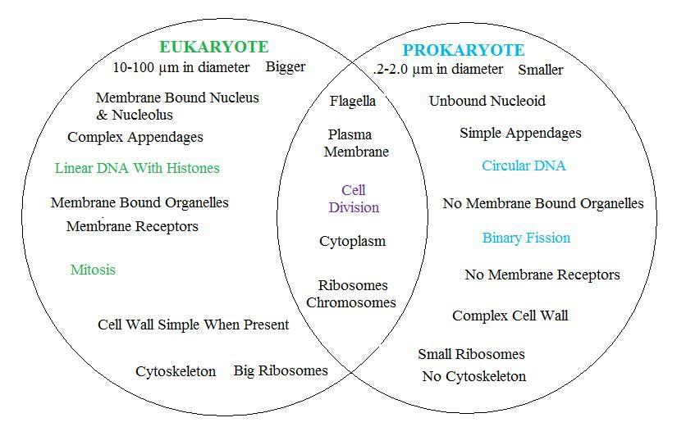
8. What is the difference between prokaryotic and eukaryotic cells?

Slide 10
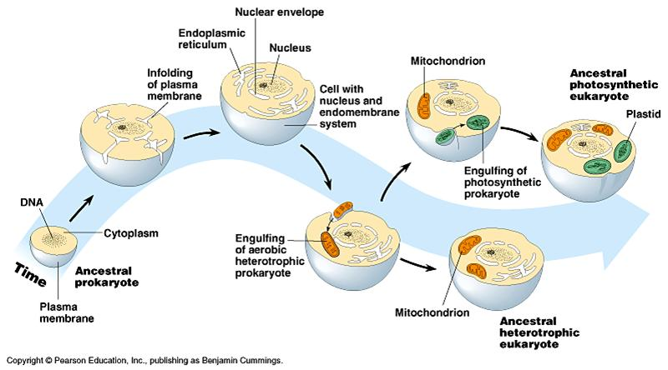
9. What is the Endosymbiotic Theory?
This is the theory on how more complicated eukaryotic cells evolved.
Proof: chloroplasts and mitochondria have their own ribosomes and DNA

Slide 11
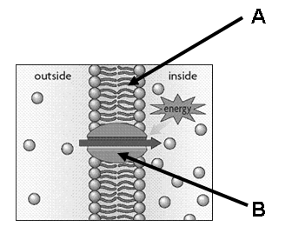
CELL TRANSPORT
1. The diagram to the right shows a typical cell membrane.
a. What type of molecules make up the cell membrane (part A)?
Phospholipids

Slide 12
CELL TRANSPORT
1. The diagram to the right shows a typical cell membrane.
b. What type of organic compound makes up the channels in the cell membrane (Part B)?
Proteins

Slide 13
CELL TRANSPORT
1. The diagram to the right shows a typical cell membrane.
c. What type of cell transport is demonstrated in the diagram and why?
Active transport: it is using energy

Slide 14
2. Label the diagram below showing the three different forms of cell transport: facilitated diffusion, active transport, and diffusion.
a. Diffusion b. facilitated diffusion c. active transport

Slide 15
3. Classify the 3 modes of cell transport seen above as either “active transport” or “passive transport”.
a. Passive b. Passive c. active

Slide 16
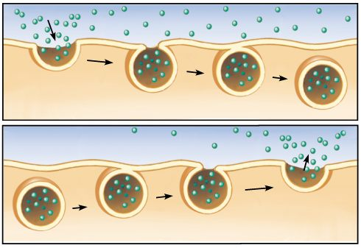
4. What is endocytosis and exocytosis? Is it active or passive transport?
They are both active transport
Endocytosis
Exocytosis

Slide 17
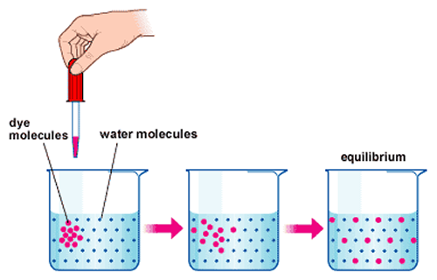
5. What determines whether something will move by way of diffusion? (Include the importance of the “concentration gradient”.)
Concentration (size and polarity also). Moves from areas of high concentration to areas of low concentration (moves with the concentration gradient)

Slide 18
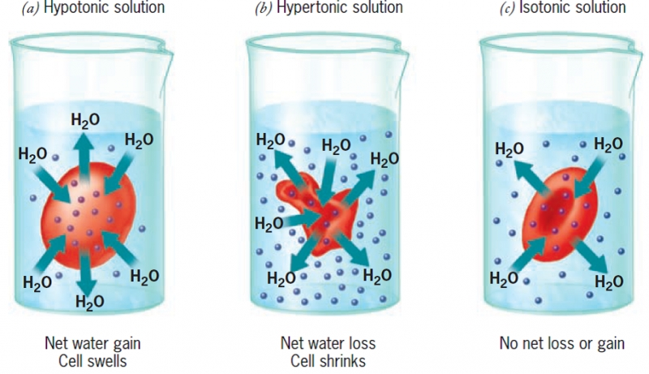
6. What is meant by the terms: isotonic, hypertonic, and hypotonic?
Isotonic = same amount of solutes
Hypertonic = higher level of solutes
Hypotonic = lower levels of solutes

Slide 19
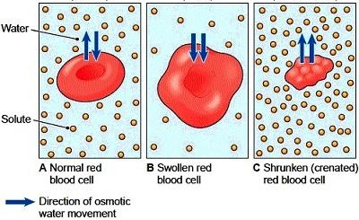
7. Which of the following images are: isotonic, hypertonic, and hypotonic? Label them
Isotonic hypotonic hypertonic

Slide 20
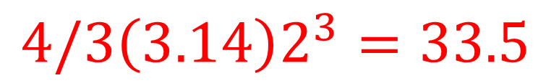
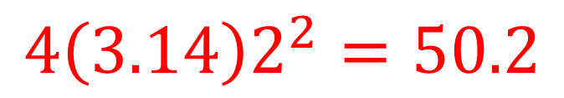
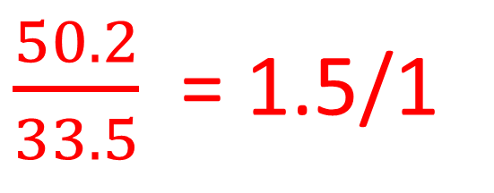
8. What is the surface to volume ratio of a spherical cell with a diameter of 4 cm? (HINT: sphere surface area = 4Πr² and sphere volume = 4/3 Π r³ )
$$4\left(3.14\right)2^{2}=50.2$$
$$4/3\left(3.14\right)2^{3}=33.5$$
$\frac{50.2}{33.5}$ = 1.5/1

Slide 21
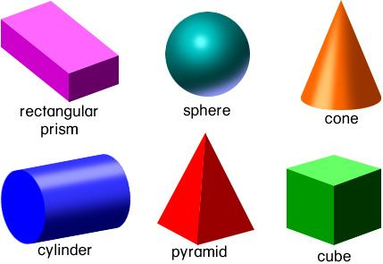
9. Which of the following cell shapes would be ideal for long cells such as skeletal muscle cells? Why? (Hint: surface area to volume ratio)
Cylinder: it maintain more surface area than other shapes as it grows longer.

Slide 22
10. Which cell shape would be good for cells like fat cells or skin cells? Why?
Sphere : These cells usually remain small enough to maintain adequate surface to volume ratio

