Slide 1
Lab: Wheat Germ DNA Extraction
HONORS BIOLOGY: UNIT 4
GRADING RUBRIC
TOTAL POINTS = 50
Lab questions = 42
Successful DNA extraction = 14
TOTAL = 56

Slide 2
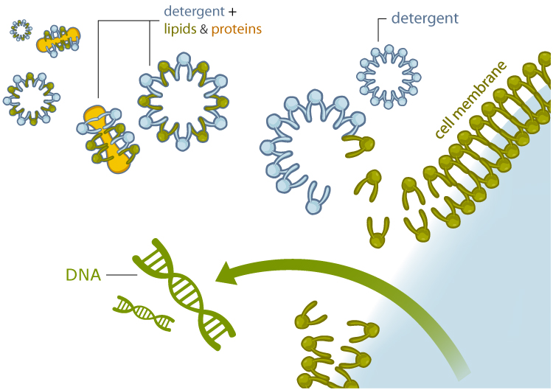
QUESTIONS:
1. What was the purpose of using a detergent to prepare our DNA sample? Detergents solubilize and break down the lipids and proteins that form the primary cell membrane and disrupt the bonds that hold the membrane together.
2 points

Slide 3
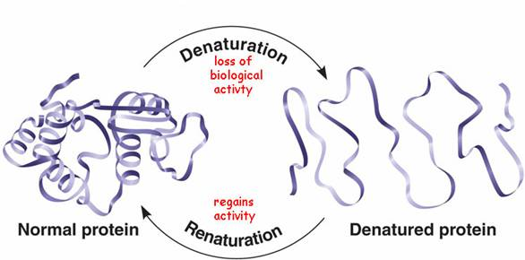
2. What does the term denature mean? What affect does increased temperature have on this process? The heat also denatures enzymes that might otherwise damage the DNA. You will also be cautioned to keep the temperature below 60° C– because higher temperatures denature the DNA and make spooling impossible.
2 points

Slide 4
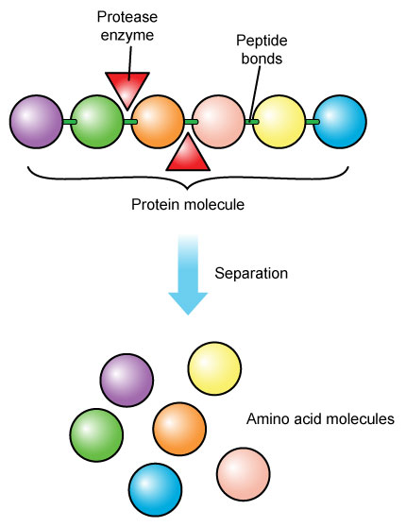
3. What is a proteolytic enzyme, and how was it used in this laboratory experiment? The meat tender-izer contains the proteolytic (protein breaking) enzyme papain– naturally present in papaya, pineapple, and other fruits. The papain completes the breakdown of the nuclear membrane, at which point the DNA is freely in solution.
2 points

Slide 5
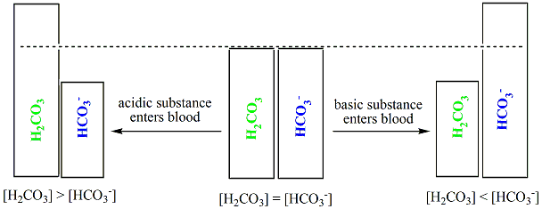
4. What was the reason you added sodium bicarbonate to your mixture? The sodium bicarbonate solution is added to maintain a near-neutral pH at which the DNA is most stable and at which the enzyme present in the meat tenderizer is most effective.
2 points

Slide 6
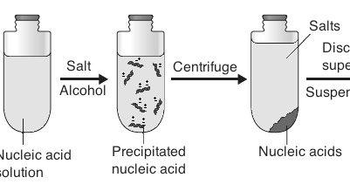
5. Why was cold alcohol used to precipitate the DNA?
The alcohol dehydrates and precipitates the DNA, as DNA is insoluble in the alcohol (especially cold alcohol).
2 points

Slide 7
6. f you did not get good results in this lab, what do you think you did wrong? (If you were successful, do you think there was anything you could have done to improve your results?)
Answers may vary. Identify at least one thing that could have been changed
2 points

Slide 8
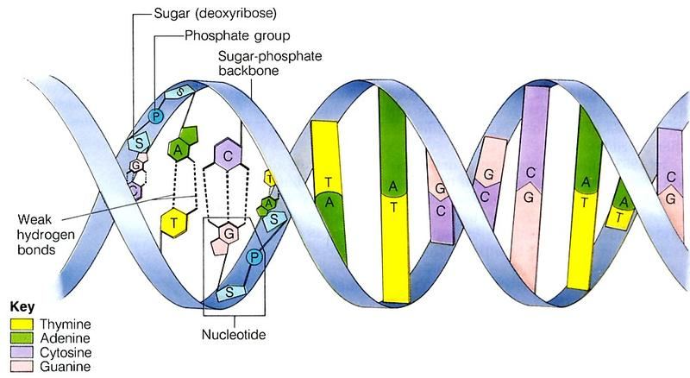
7. Draw and label the general structure of the DNA molecule and identify the following: nucleotides, nitrogen bases, deoxyribose, phosphate group, hydrogen bonds between nucleotides, covalent bonds between nucleotides, and complimentary bases.
8 points

Slide 9
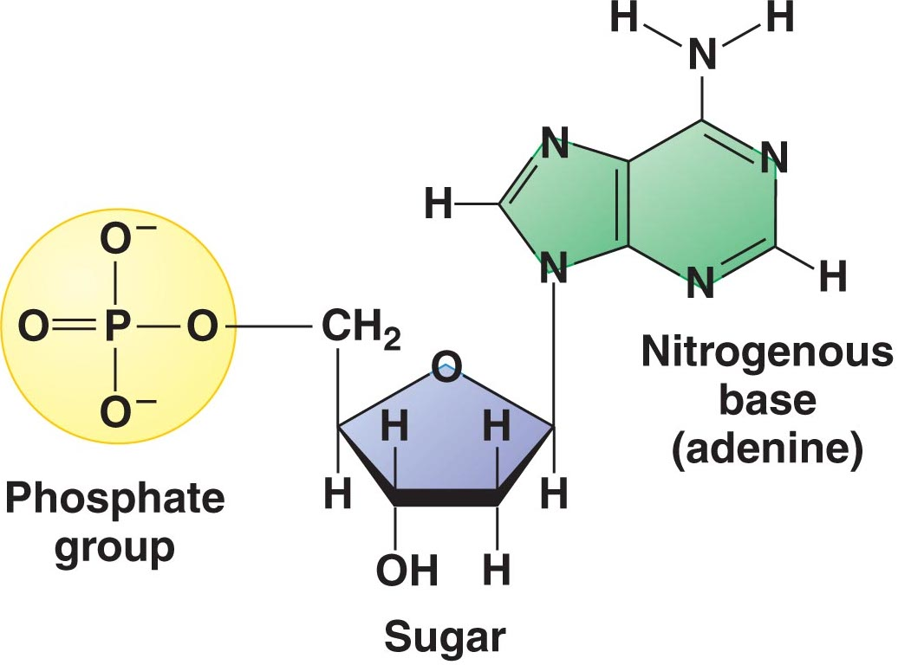
8. DNA is a polymer formed from units called nucleotides. These nucleotides are composed of three basic parts. What are they? (draw a diagram)
2 points

Slide 10
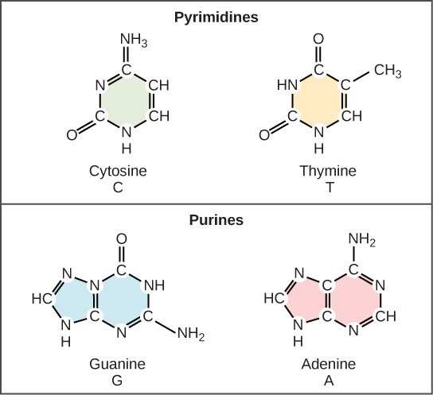
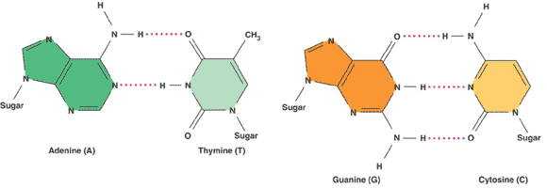
9. DNA contains four nitrogenous bases. Two of the nitrogenous bases belong to a group of compounds known as purines. The remaining two are known as pyrimidines. Identify the bases that belong to each group, give the letters that are used to represent each of them in the DNA molecule, and describe how they are different.
2 points

Slide 11
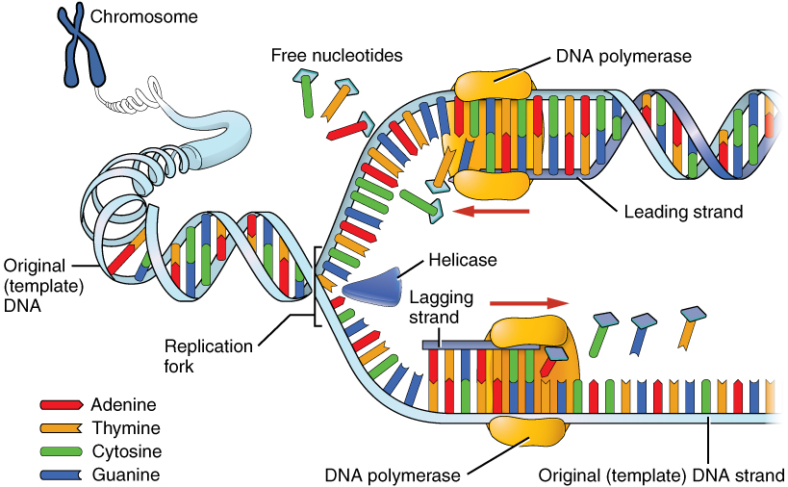
CONCLUSION:
1. What is the major significance of having 2 strands in the DNA molecule? To be able to replicate (copy) itself prior to cell division
23
points

Slide 12
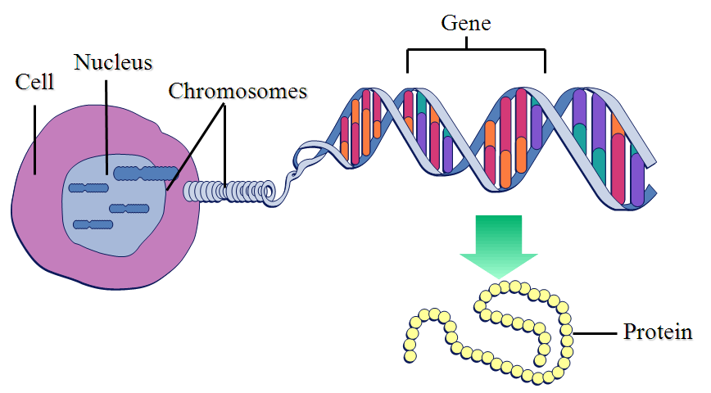
2. DNA is said to control all of the cells structure and function. How does it accomplish this? DNA holds code to produce proteins (22,000 genes each code for protein. Can be functional or structural proteins)
3 points

Slide 13
3. What is the biggest thing you learned from this lab?
3 points

Slide 14
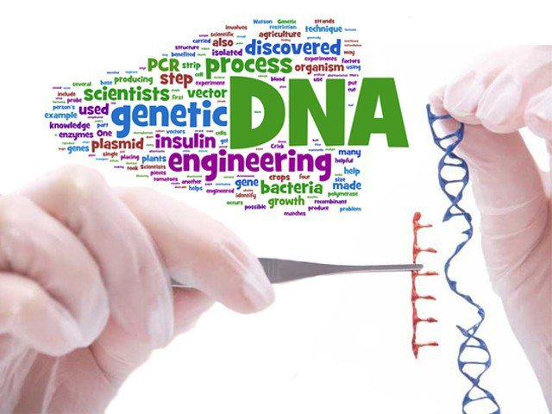
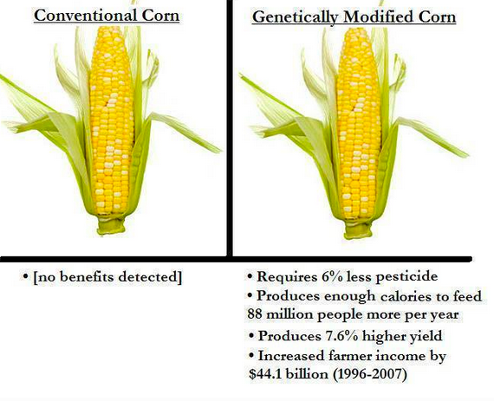
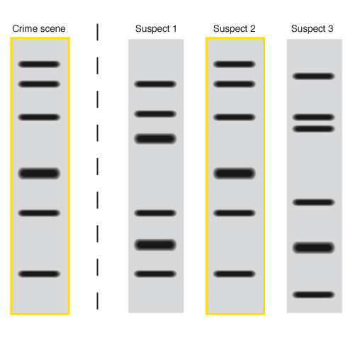
4. Give 3 examples of how DNA is used by scientists today.
3 points

Slide 15
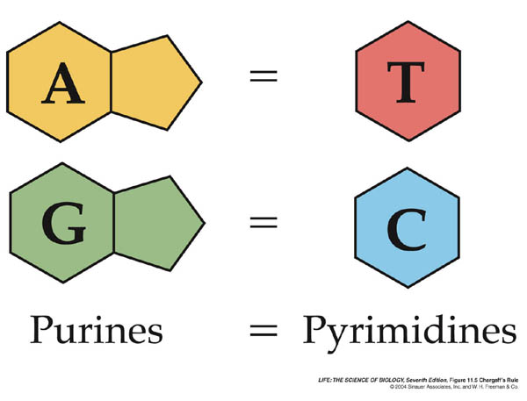
5. How did the contribution of Erwin Chargaff eventually enable Watson and Crick to determine the structure of the DNA molecule? He discovered the ratios of nitrogen bases. A = T and C = G. Helped Watson Crick determine DNA structure
3 points

Slide 16
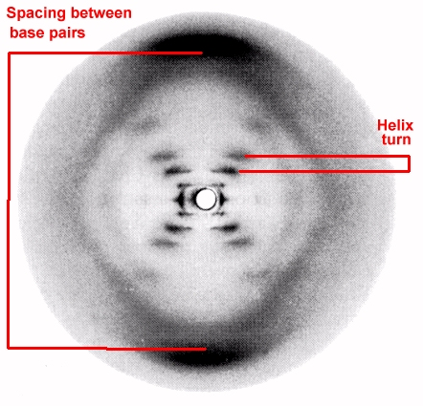
6. How did the contribution of Rosalind Franklin and Maurice Wilkens help enable Watson and Crick to determine the structure of the DNA molecule? That DNA is helical shaped
3 points

Slide 17
TOTAL POINTS = 50
Lab questions = 42
Successful DNA extraction = 14
TOTAL = 56

