Slide 1
Quiz: DNA Structure
HONORS BIOLOGY: UNIT 4
GRADING RUBRIC
TOTAL POINTS = 25

Slide 2
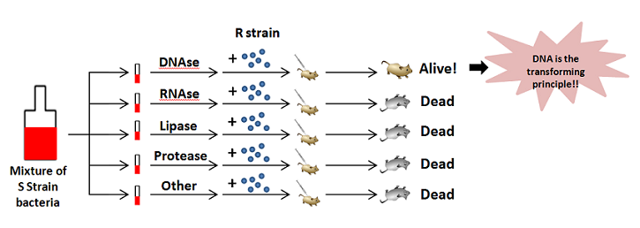
1. (5 points) What were the scientific contributions of Griffith, Avery, and Hershey & Chase towards the discovery of DNA’s importance?
They pinpointed DNA as the genetic material (“transforming principle”) in cells.
5 points

Slide 3
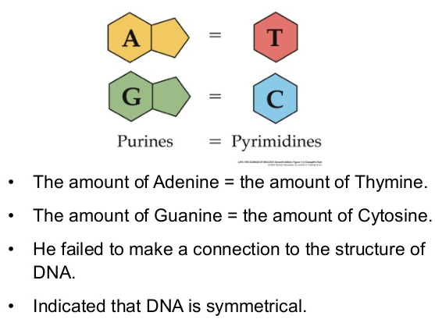
2. (5 points) What important discovery did Erwin Chargaff make that helped Watson and Crick determine the physical structure (shape) of the DNA molecule?
He discovered the amounts of each nitrogen bases A = T and C = G. Also known as Chargaff’s rule. It means that A is bonded to T and C is bonded to G. (Base pairing rules)
5 points

Slide 4
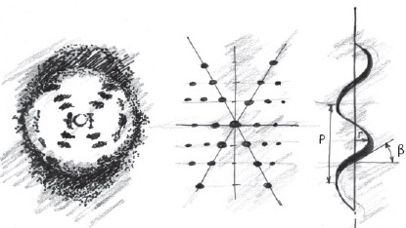
3. (5 points) What important discovery did Rosalind Franklin and Maurice Wilkins make that helped Watson and Crick determine the physical structure (shape) of the DNA molecule?
They created images using x-ray crystallography of DNA and these convinced Watson and Crick that the DNA molecule had a helical shape
5 points

Slide 5
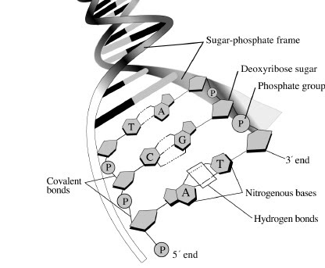
4. (10 points) Draw and label the general structure of the DNA molecule and identify (label) the following: nucleotides, nitrogen bases, deoxyribose, phosphate group, hydrogen bonds between nucleotides, covalent bonds between nucleotides, and complimentary bases (A,T,C,G).
Complimentary bases
10 points

Slide 6
TOTAL POINTS = 25

