Slide 1
GRADING RUBRIC
Lab: A Study of Lactose Intolerance
HONORS BIOLOGY: UNIT 5

Slide 2
1. Team Members: (Full names of all members)
3 points

Slide 3
2. Research Relationship (What is affecting what?)
We are testing an over-the-counter product that claims to aid in lactose digestion (breaking lactose into glucose and galactose)
The presence of lactase is affecting lactose (or the production of glucose)
2 points

Slide 4
3. Research Prediction (What results do you expect?)
I expect the Lactaid to break down lactose into glucose and galactose
Result: Glucose test strips test positive (+) for glucose after adding Lactaid to the milk (lactose)
2 points

Slide 5
4. Hypothesis (Be specific. Include a variable you are measuring. In an If/then/because form)
If…………………..then…………because……….
3 points

Slide 6
5. Experimental Design (List the steps in your procedure) Use the back page if you need more space)
Must be detailed list of steps including:
Sequence of steps
Listing materials used and tested
Quantities of materials (i.e. 3-5 drops, etc.)
When to record data and where (data table)
4 points

Slide 7
6. Independent Variable: solutions tested (Lactaid, milk, Lactaid + milk, glucose)
2 points

Slide 8
7. Dependent Variable: color change of glucose test strips- a positive (+) test for glucose (conc. of glucose)
2 points

Slide 9
8. List at least 4 other factors must be controlled?
The same amount of solution used
Same test strips
Same amount of time to soak test strips and when reading the results
Same ambient environment during testing
Same kind of materials used throughout (i.e. milk, same brand of Lactaid, same spot well, etc.)
4 points

Slide 10
9. Data Table (Create a table to collect your data in)
Solution | Glucose (+) or (-)
MILK | (-)
GLUCOSE | (+)
LACTAID | (-)
LACTAID + MILK | (+)
4 points

Slide 11
10. Proposed Plan to Analyze Data
(In what way will you compare these numbers after you collect them?)
I will look for glucose test strips results. Which were (+) indicating the breakdown of lactose in glucose, and which were (-) test results indicating no glucose was produced.
2 points

Slide 12
11. Explain what results you would need to see in your data to support your hypothesis
(+) glucose test with Lactaid + Milk
(+) glucose test with glucose
(-) glucose test with milk
(-) glucose test with Lactaid
2 points

Slide 13
12. Complete the experiment. Collect the data in your Data Table. Graph your results if appropriate. Answer the Summary Questions.

Slide 14
SUMMARY QUESTIONS
Clearly describe the results of your experiment. What happened?
Answers will vary (it should include the fact that Lactaid is effective in breaking down lactose)
2 points

Slide 15
2. Clearly explain the results of your experiment. Why did it happen?
Answers will vary (it should include the fact that Lactaid is effective in breaking down lactose as shown by (+) glucose test with Lactaid + glucose)
2 points

Slide 16
3. Which molecule is the enzyme in this experiment?
lactase
2 points

Slide 17
4. Which molecule is the substrate in this experiment?
lactose
2 points

Slide 18
5. Which molecule is the product in this experiment?
Glucose and galactose (+ lactacid)
2 points

Slide 19
6. What type of organic molecule is lactose?
Carbohydrate (disaccharide, sugar)
2 points

Slide 20
7. What type of organic molecule is lactase?
Protein (an enzyme)
2 points

Slide 21
8. Write a “word equation” to describe the chemical reaction that occurs when Lactaid is mixed with milk.
Lactaid + Milk → glucose + galactose + Lactaid
2 points

Slide 22
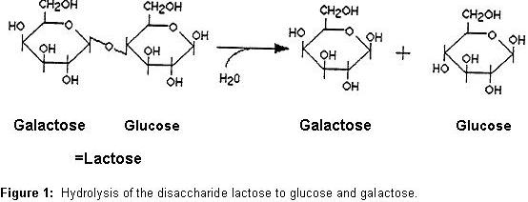
9. Is the reaction of Lactaid and lactose sugar dehydration synthesis or hydrolysis? How do you know?
Hydrolysis
because you are adding water (water is reactant)
2 points

Slide 23
10. Is this reaction an example of anabolism or catabolism?
Catabolism (breaking big molecule in smaller molecules)
2 points

Slide 24
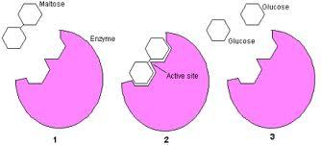
11. Are enzymes used up after they do their job of helping build a molecule or helping breakdown a molecule… or are they used again? Explain.
No. Enzymes are not used up during the reaction. They can be used over and over again.
2 points

Slide 25
12. Can any enzyme be used to help in any reaction? Explain
No. Enzymes have unique 3-dimensional shapes that determine their function. (One enzyme for each different reaction)
2 points

Slide 26
13. Explain why enzymes are so important to living organisms.
Almost every chemical reaction that takes place in the body requires enzymes to increase the rate at which the reaction will occur.
2 points

Slide 27
14. Suggest a possible reason why the lactase in people who are lactose-intolerant doesn’t function properly.
Answers will vary (the difference occurs in the regulating portion of the DNA which can turn on or off the production of specific proteins)
2 points

Slide 28
15. What was the control in your experiment?
Testing the Lactaid, milk, or glucose with glucose test strips
Milk by itself: Test to make sure there is not glucose in milk already
Glucose by itself: make sure the test strips actually indicate the presence of glucose
Lactaid: test whether glucose might already exist in the Lactaid
2 points

Slide 29
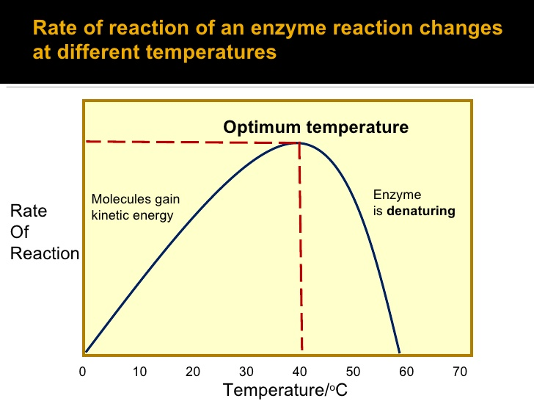
16. Would Lactaid work if I put it in my Starbuck’s cappuccino? Explain.
No (not very well). Enzymes only work within a narrow temperature range. The temperature of the cappuccino would denature the enzyme (changing its shape) causing is to no longer function
2 points

Slide 30
17. Predict the temperature for the optimal functionality of Lactaid. Explain.
Somewhere close to normal body temperature
2 points

Slide 31
18. In the following diagram, number the steps of the Enzyme Cycle (#1, #2, #3), place arrows to show the sequence of events and label: lactase (Lactaid), lactose, glucose, galactose
#2
#1
#3
lactase
lactase
glucose
lactose
galactose
2 points

Slide 32
19. Use the following Data Table to make a bar graph representing the prevalence of Lactose Intolerance. (Make sure to include title and label axes)
Lactose intolerance
Groups | Percent Intolerant
British | 12
South Americans | 63
Chinese | 97
European Americans | 12
French | 18
African Americans | 75
Hispanic Americans | 53
Asian Americans | 90
100
75
50
25
0
Percent intolerant
British
S. Americans
Chinese
European A.
French
African A.
Hispanic A.
Asian A.
Ethnic origins
2 points

Slide 33
a. Which groups have the highest incidence rate of Lactose Intolerance? Chinese Americans
b. Which groups have the lowest incidence rates of Lactose Intolerance? British and European Americans
2 points

Slide 34
TOTAL POINTS = 70
2 points

