Slide 1
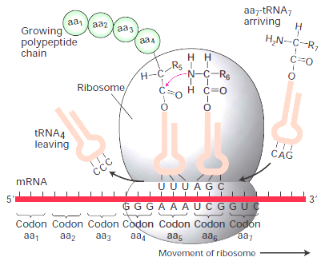
GRADING RUBRIC
Worksheet: Unit 5 Test Review

Slide 2
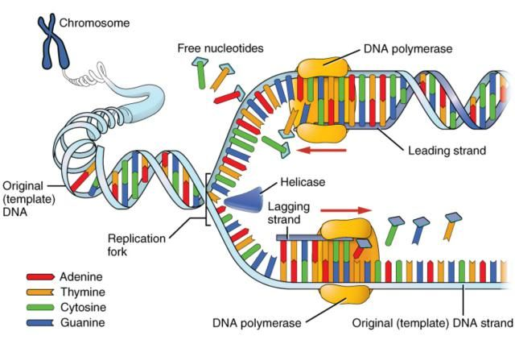
1. Describe and draw a diagram of the processes below (include where it occurs, what molecules are involved, sequence of events, and what results from each process):
Replication: DNA making DNA. Making an exact copy of itself before cell division. Involves enzymes. Takes place in nucleus.
Steps:
Enzyme begins to unzip DNA
Hydrogen bonds broken
Molecule separates exposing bases
Free-floating nucleotides pair up with complementary bases

Slide 3
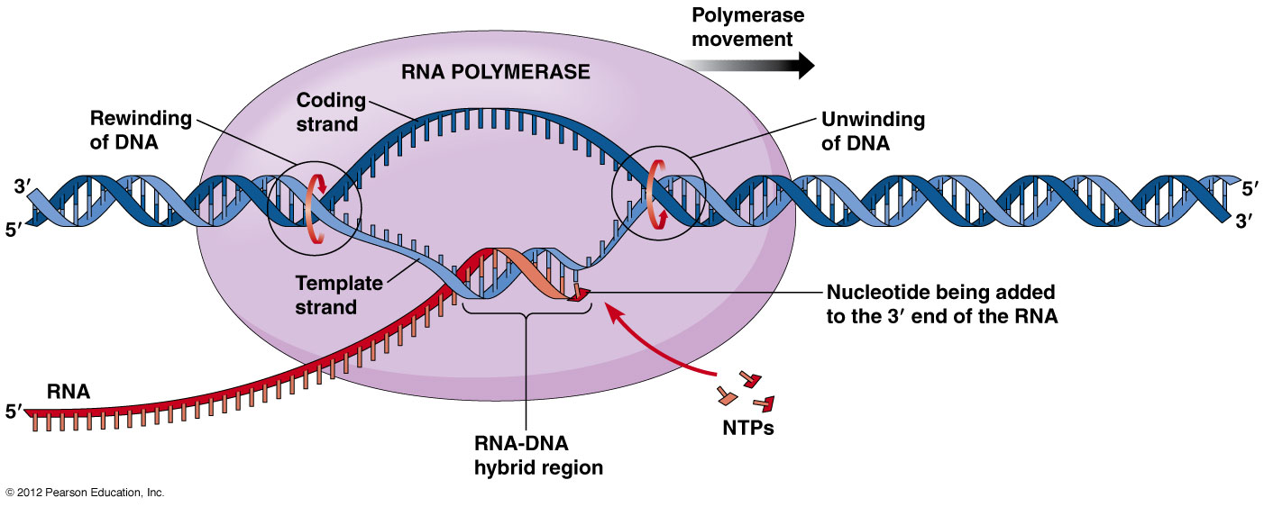
Transcription: DNA making RNA. DNA used to make ‘disposable’ copy of one genes worth of information to travel to ribosome in cytoplasm to make protein. Takes place in nucleus.

Slide 4
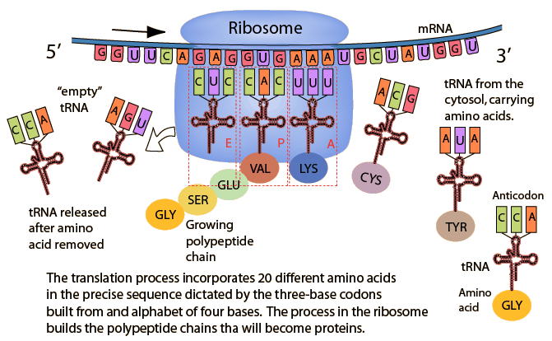
Translation: RNA making proteins. mRNA attaches to ribosome (made of rRNA) and tRNA molecules transfer amino acids to ribosome to be bonded together and make into polypeptide (protein). Involves mRNA, tRNA, and rRNA.

Slide 5
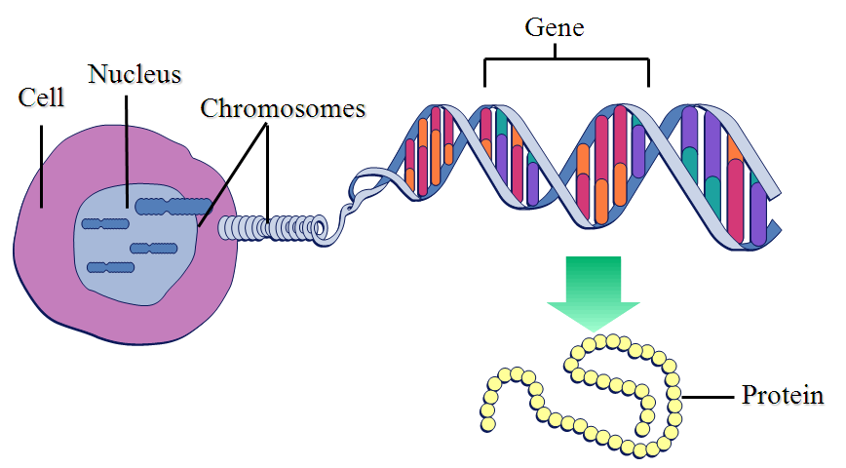
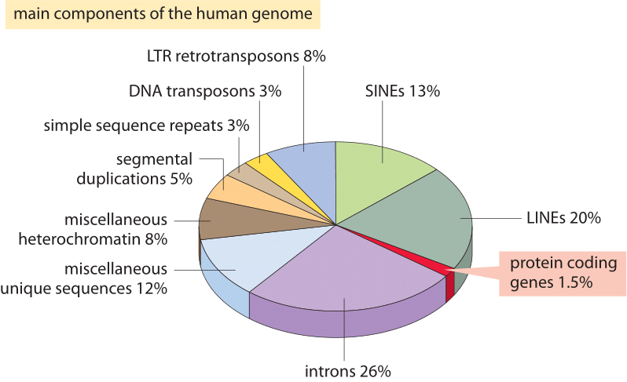
2. Genes contain instructions for producing proteins
Human DNA contains about 22,000 genes. Each codes for production of either structural or functional proteins. (Protein coding DNA makes up on 2% of total DNA)

Slide 6
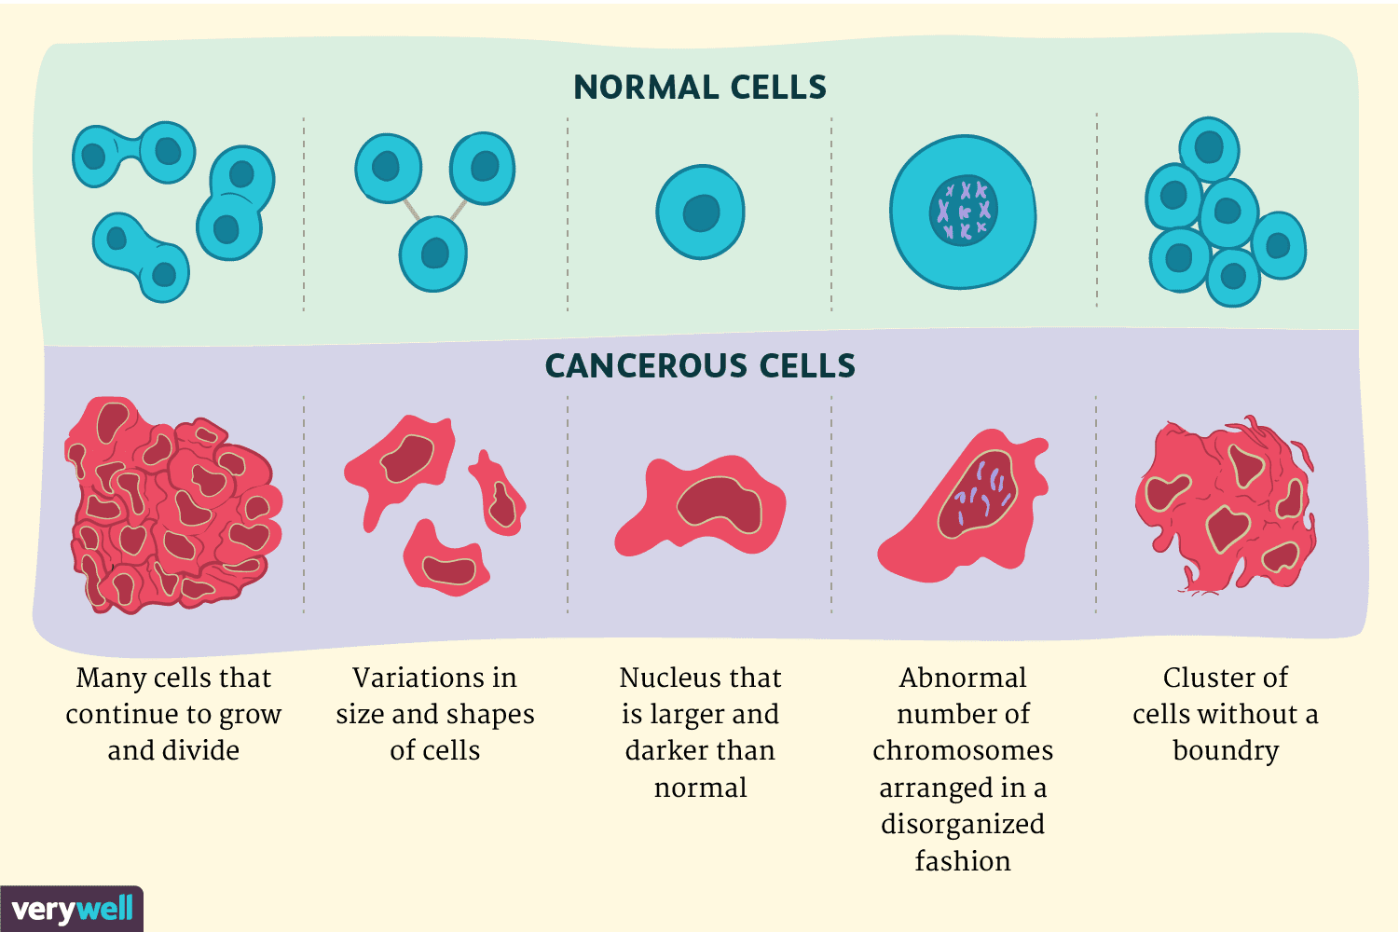
3. Cancer is a disorder in which some cells have lost the ability to control what? To control cell division.
Cancerous cells continue to grow and produce masses called tumors.
Can be malignant (can spread) or benign (do not spread)

Slide 7
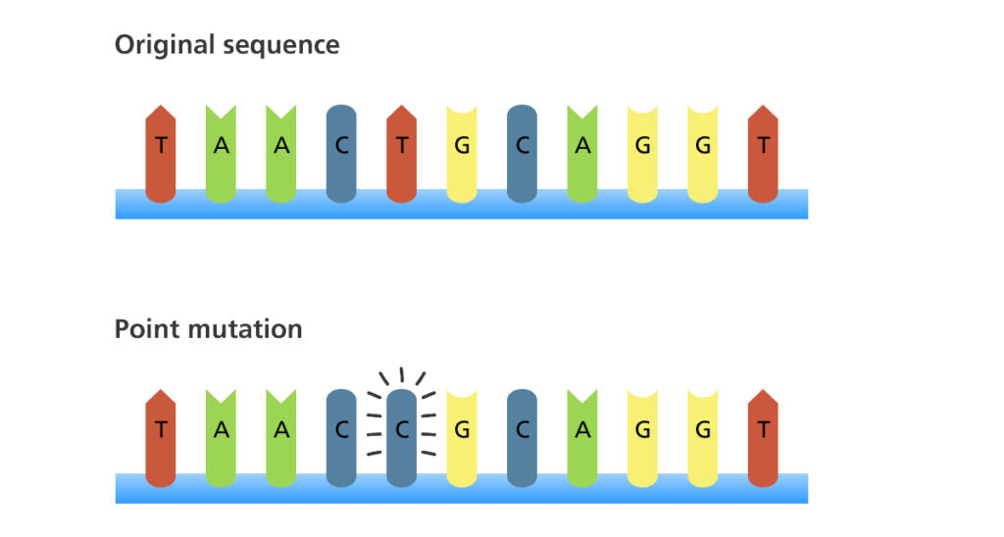
4. Mutations that affect a single gene normally occur during DNA replication. Can involve single base change (point mutation), or frameshift mutation. (occurs in the S phase of the Cell Cycle)

Slide 8
5. Mutations that affect multiple genes normally occur during meiosis
Nondisjunction can result in either extra chromosomes or missing chromosomes. Crossing-over can also create changes in offspring’s DNA.

Slide 9
6. How might a mutation affect the resulting protein produced? A mutation may or may not affect the resulting protein.
A mutation may be silent
A mutation may occur in a noncoding region
A mutation may not affect protein folding or the active site.
A mutation may cause a premature stop codon.
A mutation may change protein shape or the active site
A mutation may change gene regulation

Slide 10
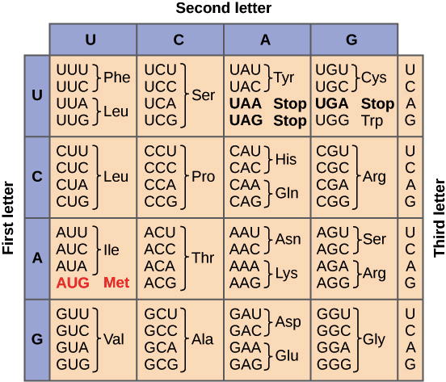
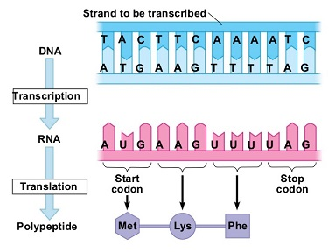
7. What is a codon and what does it do? A codon is a 3-letter ‘code word’ to specify one amino acid (E.g. GAU). There are only 20 amino acids and 64 different codons. There are multiple codons that code for same amino acid

Slide 11
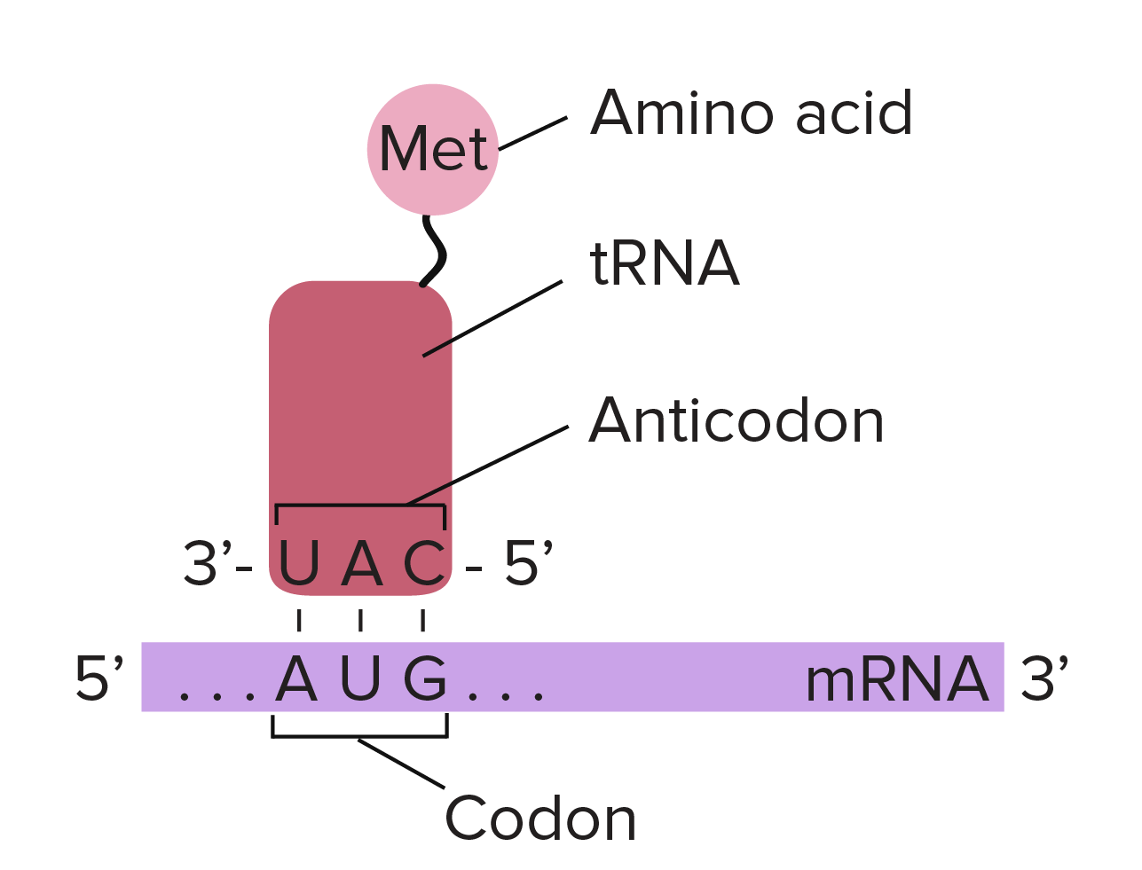
8. What is an anticodon and what does it do? An anticodon is a 3-letter ‘code word’ that is found on tRNA molecule. The anticodon is complementary to the codon. Complementary codons are A-U and C-G
Complementary base pairing

Slide 12
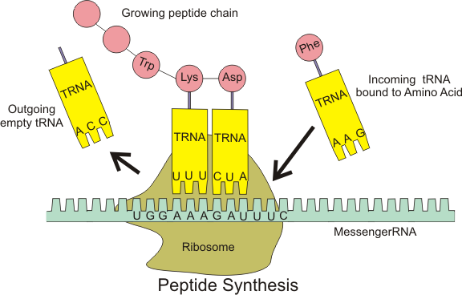
9. How many codons would it take to code for 5 amino acids? Five. Each codon codes for one amino acid.

Slide 13
10. How many nitrogen bases does it take to code for 5 amino acids? 15 bases. 3 bases per codon x 5 = 15 bases
One codon = 3 bases

Slide 14
11. Why is it possible for an amino acid to be specified by more than one kind of codon? There are only 20 amino acids but 64 possible 3-letter combinations (codons)

Slide 15
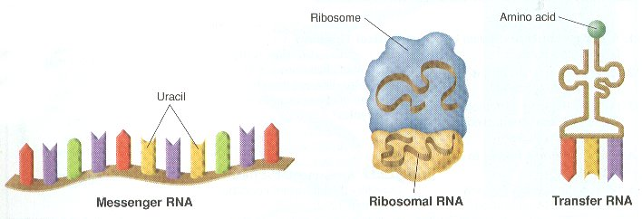
12. What are the three types of RNA, where are they found and what do they do?
Messenger RNA (mRNA)- code for translation
Ribosomal RNA (rRNA)- forms part of ribosome
Transfer RNA (tRNA)- brings amino acids from the cytoplasm to a ribosome to help make growing protein

Slide 16
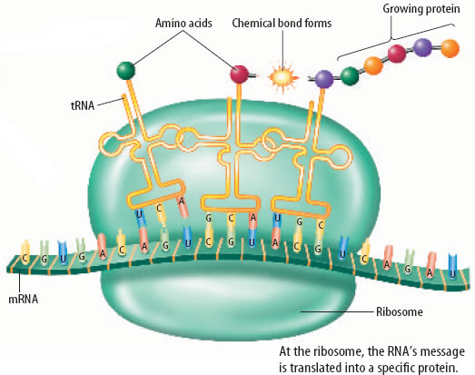
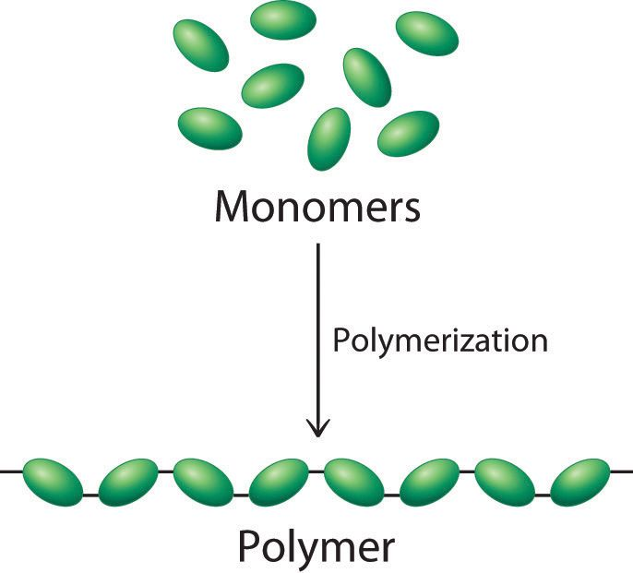
13. What is the monomer of a protein? amino acid. (There are 20 different amino acids that make up all proteins)
Amino acids
Protein

Slide 17
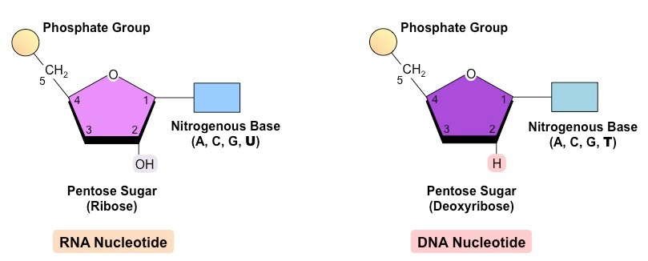
14. What is the monomer of a nucleic acid? A nucleotide.
Nucleotides slightly different in DNA and RNA
Sugars different
One base different in RNA (replace “T” with “U” in RNA)

Slide 18
15. What are the similarities and differences of DNA and RNA?
Similarities:
Both made of nucleotides
Both made in the nucleus (in eukaryotes)
Both carry genetic code
Code read 3 bases at a time
Differences: RNA differs from DNA in three significant ways
Sugar in RNA is ribose not deoxyribose
RNA has the base uracil in place of thymine
RNA is single stranded not double

Slide 19
16. If one side of a DNA molecule contains the following sequence of nucleotides, GCATTCGCA, the complementary sequence on the other side would be:
GCATTCGCA
CGTAAGCGT
A’s goes with T’s and C’s goes with G’s

Slide 20
1 17. What would the mRNA molecule look like that is transcribed from the following DNA sequence? GCATTCGCA
GCATTCGCA
CGUAAGCGU
A’s goes with U’s and C goes with G’s
.

Slide 21
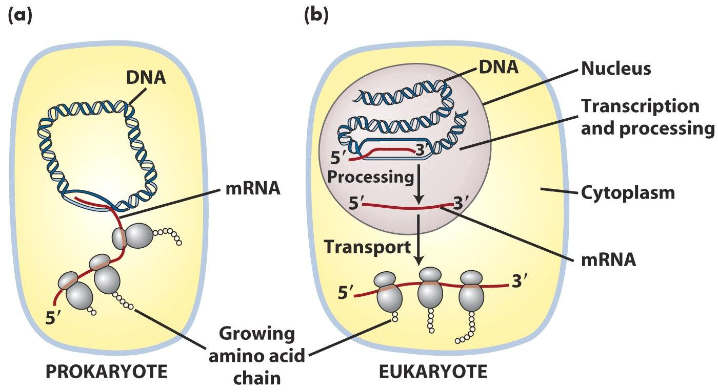
18. How do replication, transcription, and translation differ in prokaryotes and eukaryotes?
Prokaryotes
Replication, transcription and translation occurs in cytoplasm (no nucleus)
Eukaryotes
Replication and Transcription in nucleus
Translation occurs in cytoplasm

Slide 22
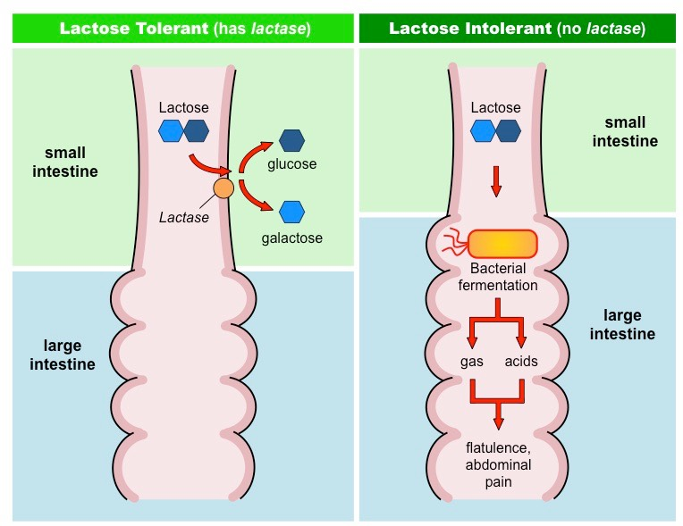
19. Lactose tolerance, also known as lactase persistence, is caused by? A mutation in the regulatory portion of the lactase gene causes the gene to stay “on” as adults allowing them to produce the enzyme lactase. The gene itself is unaffected.

Slide 23
20. What is the variable portion of a nucleotide? The nitrogen bases differs. (DNA: ATCG. RNA: AUCG)

Slide 24
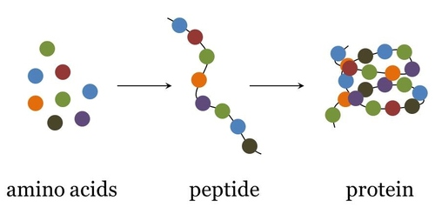
21. Even though there are only 20 amino acids thousands of different types of proteins can be made in the human body. How is this possible? The order and number of amino acids determines the specific protein structure. (like spelling different words in English language)
Each protein will ‘fold’ into a unique shape based on order of amino acids (they form hydrogen bonds between specific amino acids and produce unique 3-D shape)

Slide 25
22. Why is it possible that a mutation may not affect the phenotype of an individual?
A mutation may be silent
A mutation may occur in a noncoding region
A mutation may not affect protein folding or the active site.
A point mutation may still code for the same amino acid

Slide 26
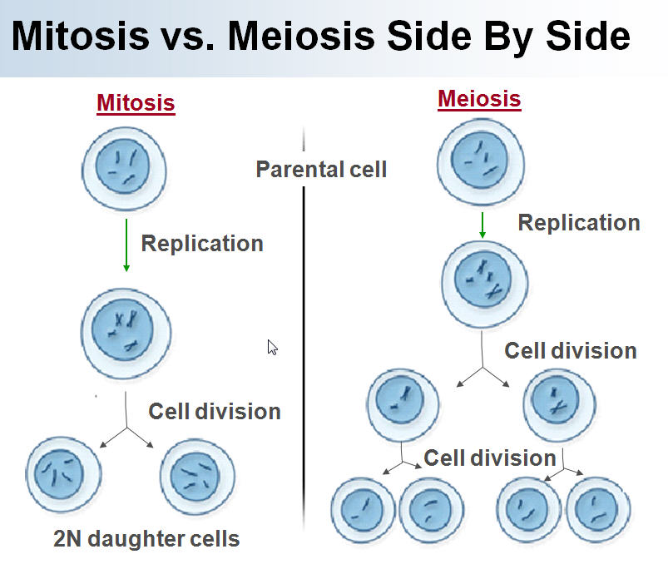
23. What is the difference between a germ cell and a somatic cell? (Where are they found and how are they made?
Germ Cells: cells in your reproductive organs, the ovaries and testes. Germ cells undergo meiosis and develop into gametes (called sex cells). Form egg and sperm cells.
Somatic Cells: Also known body cells. They make up most of your body tissues and organs. Somatic cells produced by mitosis

Slide 27
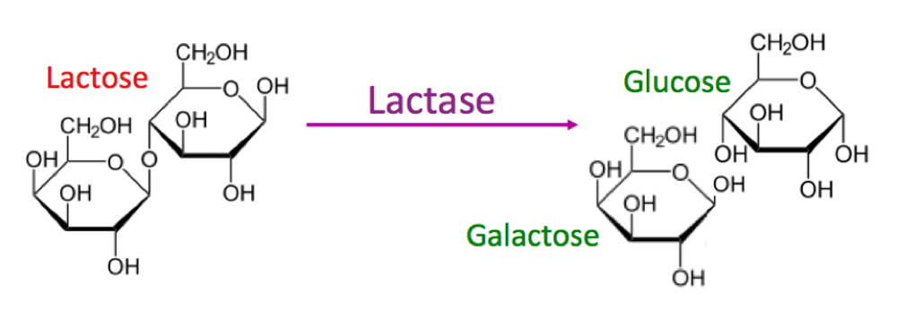
24. What type of organic molecule is lactose?
A carbohydrate
(specifically lactose is a disaccharide. Sugars like lactose usually end in “…ose” whereas enzymes end in “…ase”)

Slide 28
25. What type of organic molecule is lactase? A protein.
Lactase is an functional protein (enzyme).
(Enzymes are not used up in reaction. They can be used over and over again)

Slide 29
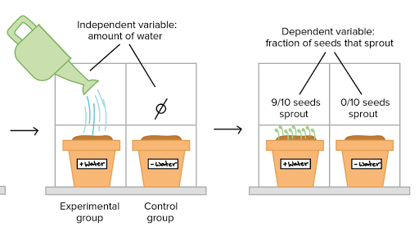
26. What was the control in the Lactose Intolerance lab? Milk (Milk was tested so we could compare results when lactase was added to the milk. It set a benchmark to compare with)
In this experiment one of the plants is not given water so you can compare with plant that did.

Slide 30
127. Which molecule was the substrate in the Lactose Intolerance lab? Lactose
Unique 3-D shape of substrate matches unique 3-D shape of enzyme forming enzyme-substrate complex

Slide 31
28. Write a “word” equation for the breakdown of lactose. (Include all reactants and products.)
Lactase + lactose → lactase + glucose + galactose
Enzyme is both reactant and product

Slide 32
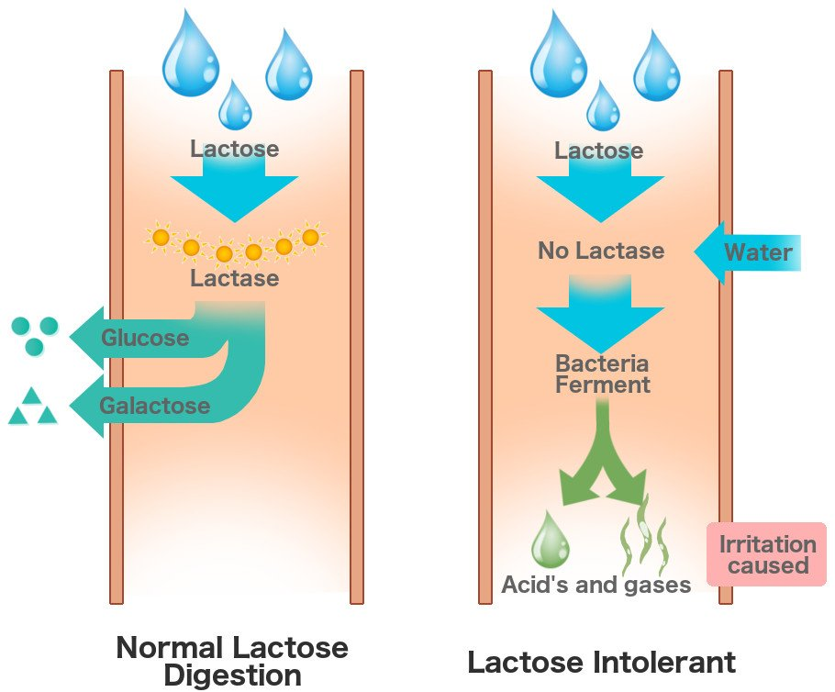
29. Why is lactose tolerance also called lactase persistence? A mutation caused the lactase gene to remain ‘turned on’ as an adult. These people are able to digest lactose (lactose tolerant) because the lactase gene is still turned on.

