Slide 1
GRADING RUBRIC
Worksheet: Unit 6 Test Review
HONORS BIOLOGY: UNIT 6

Slide 2
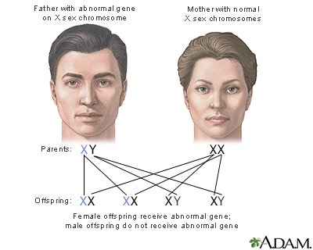
Part 1: Define the following terms:
1. Genetics- The study of biological inheritance
2 points

Slide 3
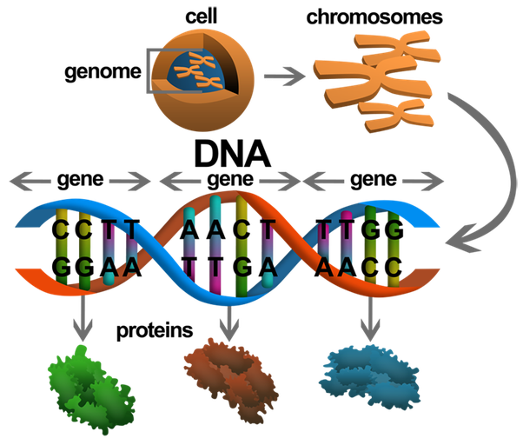
2. Gene- small section of DNA that contains instruction (code) to make a specific protein (protein can be structural or functional)
2 points

Slide 4
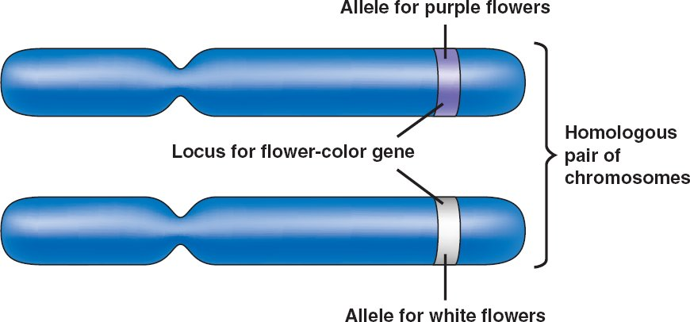
3. Allele- Different forms of a gene. Example: gene for flower color can be white or purple
2 points

Slide 5
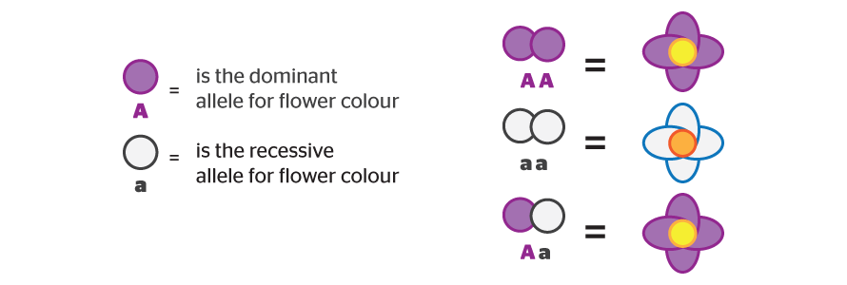
4. Dominant- Allele expressed when 2 different alleles (Aa) OR 2 dominant alleles are present (AA)
2 points

Slide 6
5. Recessive- Allele only expressed if 2 copies of recessive are present (aa)
2 points

Slide 7
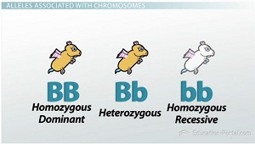
6. Homozygous- Two of the same allele (eg BB, bb)
2 points

Slide 8
7. Heterozygous- Two different alleles (eg Bb)
2 points

Slide 9
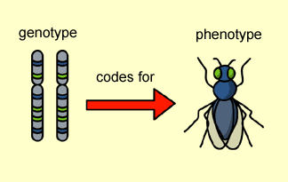
8. Genotype- Genetic makeup of a specific set of genes (eg BB, Bb, bb)
2 points

Slide 10
9. Phenotype- Physical characteristics of offspring. E.g- tall or short, white flower or purple flower
2 points

Slide 11
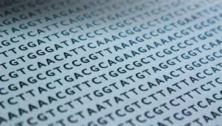
10. Genome- Collection of all the organism’s genetic material
2 points

Slide 12
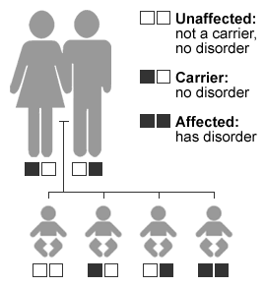
11. Carrier- Heterozygous for recessive disorder; carries allele for disorder but doesn’t express symptom.
E.g.- color blindness. Females (X^{C}X^{c}) can be carriers but males (X^{C}Y) cannot
2 points

Slide 13
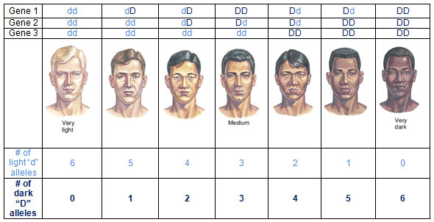
12. Polygenic traits-Traits determined by two or more genes (e.g. skin color)
2 points

Slide 14
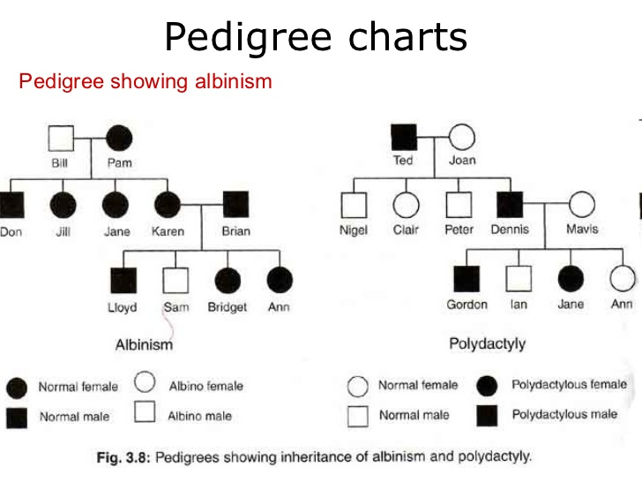
13. Pedigree- a “family tree” of genetic traits
2 points

Slide 15
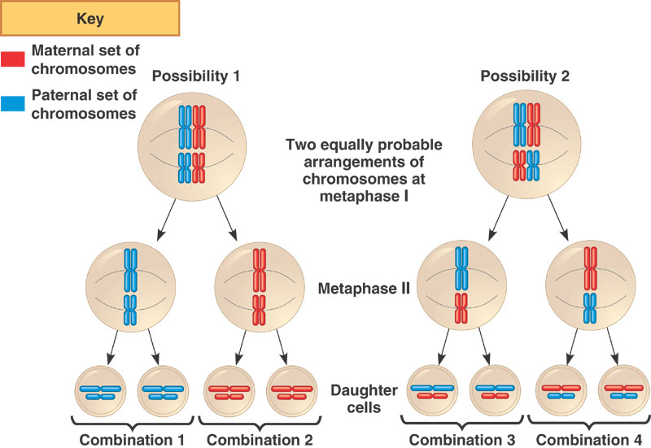
14. Independent assortment- allele pairs separate independently of each other during meiosis
2 points

Slide 16
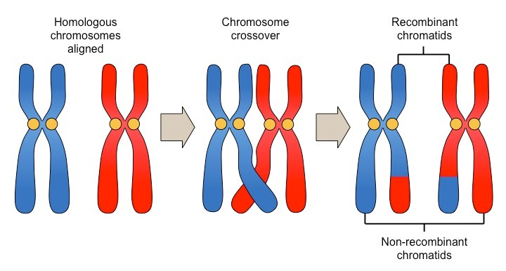
15. Crossing over- the exchange of portions of their chromosomes with neighboring chromosome that takes place in meiosis. Produces new combinations
2 points

Slide 17
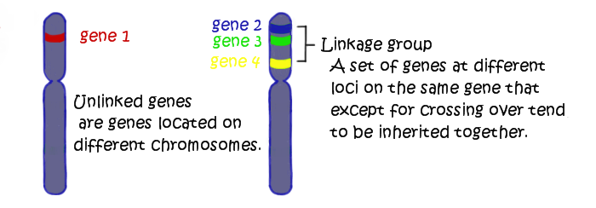
16. Linked genes-Genes located on same chromosome inherited together
Closer together = higher chance of inheriting together
If far apart, crossing over may separate them
2 points

Slide 18
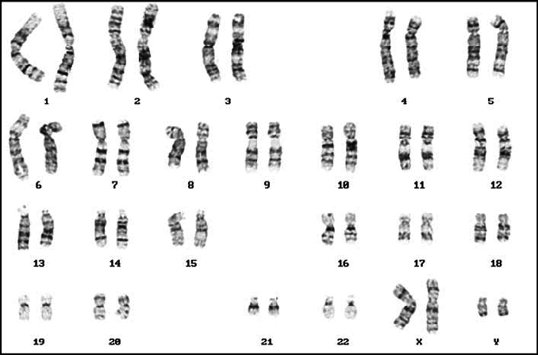
17. Karyotype- a photograph of a complete set of chromosomes.
  18. Autosomes- the first 22 pairs of chromosomes
  19. Sex chromosomes- the 23rd pair (XX) female and (XY) male
6 points

Slide 19
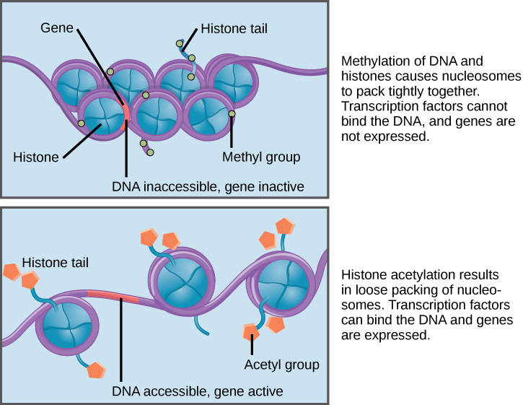
20. Epigenetics- the study of changes in organisms caused by modification of gene expression rather than alteration of the genetic code itself.
2 points

Slide 20
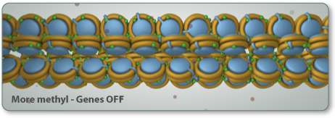
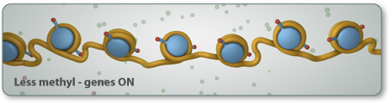
  21. Epigenome- It is a “second layer” of structure of DNA- the histones and chemical tags causes genes to be turned on or off. Epigenome reacts to outside signals (i.e. stress, diet)
  22. Imprinted gene- A inherited gene that has maintained its epigenetic tags (they were not reprogramed/erased)
  23. Methyl and acetyl groups- more methyl groups causes winding-up of DNA and genes are turned off.
6 points

Slide 21
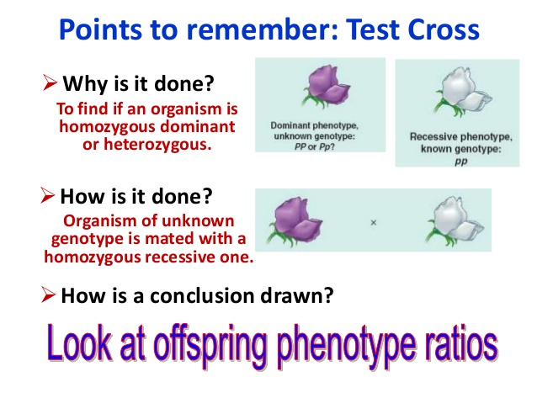
24. Test Cross- a cross made on known phenotypes to determine the genotypes of parents
2 points

Slide 22
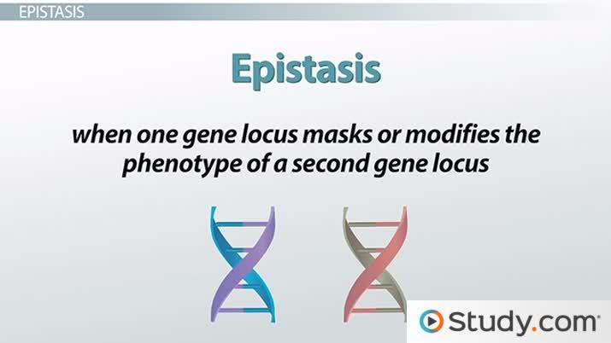
25. Epistasis- when the presence one gene “overpowers” other genes (e.g. the gene responsible for albinism)
PHENOTYPE | GENOTYPE (MC1R) | GENOTYPE (ASIP)
Red | EE or Ee | A_{y}/A_{y}
Black and Tan | EE or Ee | a_{t}/a_{t}
Sesame | EE or Ee | A_{y}/a_{t}
Cream | ee | A_{y}/A_{y} or a_{t}/a_{t} or A_{y}/a_{t}
2 points

Slide 23
26. Linked genes- Genes found on the same chromosome.
  1. Closer together- more likely inherited together 2. Further apart- more likely will be separated during meiosis.
2 points

Slide 24
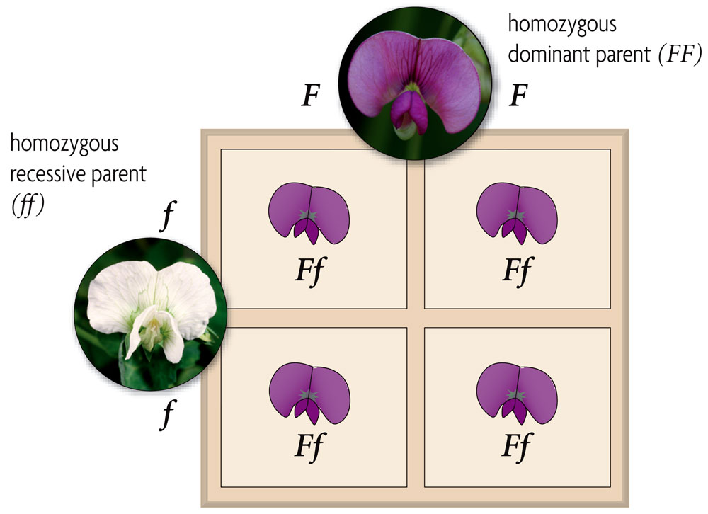
Part 2: Describe the following types of genetic crosses. Include an example.
1. Dominant/recessive- either/or traits
2 points

Slide 25
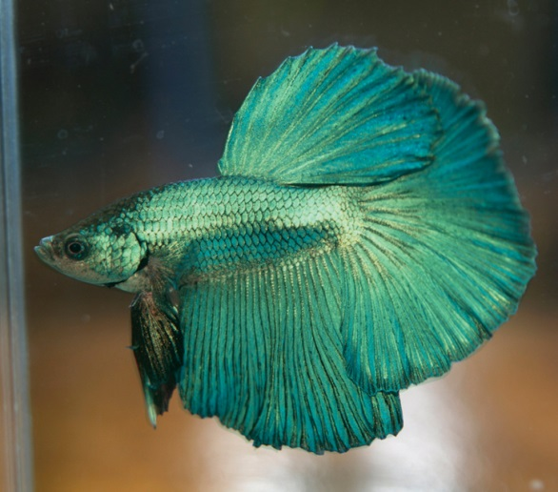
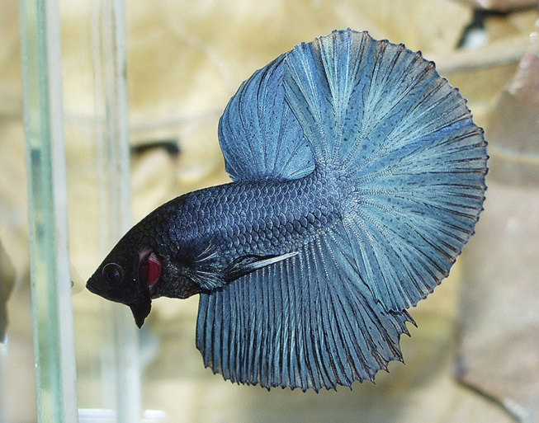
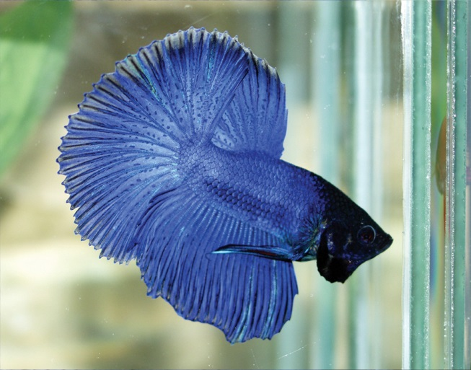
2. Incomplete dominance- heterozygous offspring’s phenotype is a blending of traits (red X white = pink)
Phenotype Genotype
green B₁B₁
Phenotype Genotype
Steel blue B₂B₂
Phenotype Genotype
Royal blue B₁B₂
2 points

Slide 26
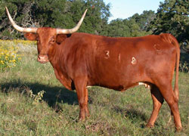
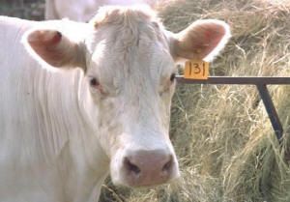
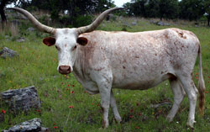
3. Codominance- both alleles dominant. In heterozygous offspring they have both red and while hair (not pink)
X
=
red white roan
2 points

Slide 27
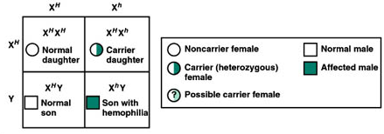
4. Sex-linked- genes that are carried on the X-chromosome.
Males 10 times more likely to have a sex-linked trait.
Only females can be carriers
2 points

Slide 28
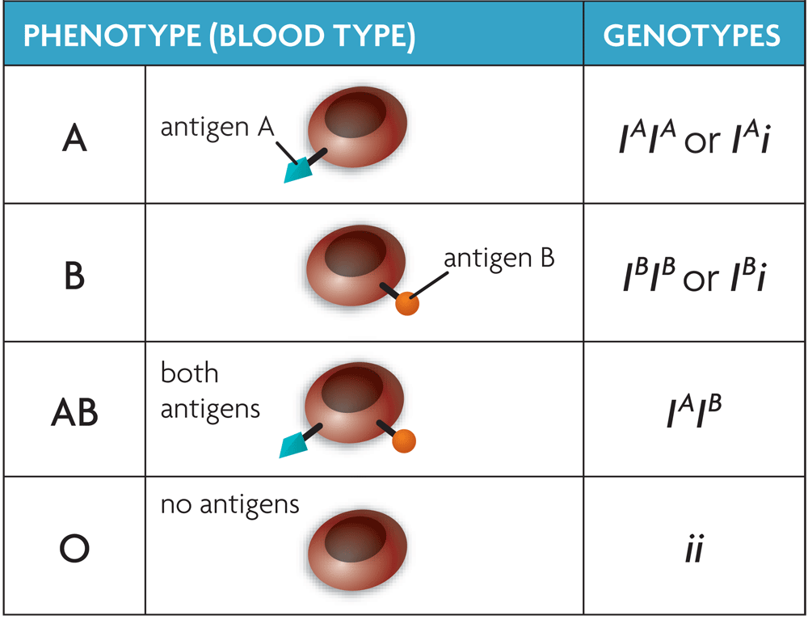
5. Multiple alleles- When there are more than 2 alleles for a trait. E.g. blood type
2 points

Slide 29
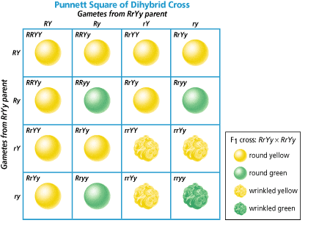
6. Dihybrid cross- a genetic cross involving two genes at once. Phenotypic ratio of offspring 9:3:3:1 when crossing to heterozygous individuals
2 points

Slide 30
Part 3: Punnett Squares
1. Assume that blood type is inherited as A and B dominant over O, but A and B are codominant over each other. Genotypes (I^{A} I^{A}) and (I^{A} i) are then phenotypically type A, genotypes (I^{B} I^{B}) and (I^{B} i) are type B, genotype (I^{A} I^{B}) is type AB, and genotype (i i) is type O blood. A man with blood type I^{A} I^{B} marries a woman with type i i blood. What are the genotypic and phenotypic ratios of the offspring?
I^{A} I^{B} X ii
I^{A} I^{B}
I^{A} i | I^{B} i
I^{A} i | I^{B} i
Genotypic ratio: 1:1
Phenotypic ratio: 1:1
i
i
2 points

Slide 31
2. In certain breeds of dogs, deafness is due to a recessive allele (d) of a particular gene, and normal hearing is due to its dominant allele (D). A heterozygous normal dog is crossed with heterozygous normal dog. What are the genotypic and phenotypic ratios of the offspring?
Dd X dd
D d
DD | Dd
Dd | dd
Genotypic ratio: 1:2:1
Phenotypic ratio: 3:1
D
d
2 points

Slide 32
3. In snapdragons, red (R) is not completely dominant over white (r) flowers. What color flowers would you expect when you cross a pink flower with a white flower? What are the genotypic and phenotypic ratios of the offspring?
Rr X rr
R r
Rr | rr
Rr | rr
Genotypic ratio: 1:1
Phenotypic ratio: 1:1
r
r
2 points

Slide 33
4. In humans, hemophilia is a sex-linked trait due to the recessive allele (h), and normal is due to the dominant allele (H). What is the expected offspring between a man with hemophilia and a woman who is a carrier for hemophilia? Give both genotypic and phenotypic ratios
X^{H} X^{h} x X^{h} Y
X^{H} X^{h}
X^{H} X^{h} | X^{h} X^{h}
X^{H} Y | X^{h} Y
Genotypic ratio: 1:1:1:1
Phenotypic ratio: 1:1:1:1
X^{h}
Y
2 points

Slide 34
5. In rabbits there is a C gene which is responsible for fully colored coats. There are three other genes located at the same locus (location), c^{ch}, c^{h}, c. These genes can be arranged in a series in which each gene is dominant to the genes following it (C, c^{ch}, c^{h}, and c). Refer to the chart below which describes genotypes and phenotypes to complete the following genetic cross.
Complete the following genetic cross:
Cc^{ch} X c^{ch}c^{h}
C c^{ch}
Cc^{ch} | c^{ch}c^{ch}
Cc^{h} | c^{ch}c^{h}
c^{ch}
c^{h}
Cc^{ch} X c^{ch}c^{h}
Genotypic ratio: 1:1:1:1
Phenotypic ratio: 1:1
2 points

Slide 35
TOTAL POINTS = 72
2 points

