Slide 1
Grading Rubric
Lab: Blood Type Fingerprint Mystery
HONORS BIOLOGY: UNIT 6
Total Point = 59

Slide 2
Data Table #1
Number 1
Well | Agglutination (yes/no) | What does this tell you?
1. Anti-A | Yes | Could be A or AB
2. Anti-B | No | Must be A
3. Anti-D | Yes | Rh+
Number 2
Well | Agglutination (yes/no) | What does this tell you?
1. Anti-A | Yes | Could be A or AB
2. Anti-B | No | Must be A
3. Anti-D | Yes | Rh+
Number 3
Well | Agglutination (yes/no) | What does this tell you?
1. Anti-A | Yes | Could be A or AB
2. Anti-B | Yes | Must be AB
3. Anti-D | No | Rh-
Number 4
Well | Agglutination (yes/no) | What does this tell you?
1. Anti-A | Yes | Could be A or AB
2. Anti-B | Yes | Must be AB
3. Anti-D | Yes | Rh+
Number 5
Well | Agglutination (yes/no) | What does this tell you?
1. Anti-A | No | Could be O or A
2. Anti-B | Yes | Must be B
3. Anti-D | No | Rh-
Number 6
Well | Agglutination (yes/no) | What does this tell you?
1. Anti-A | Yes | Could be A or AB
2. Anti-B | No | Must be A
3. Anti-D | No | Rh-
12 Points (2 points each)

Slide 3
Data Table #1
Number 1
Fingerprint pattern found at scene | Other observations about fingerprints
Whorl | Answers will vary
Number 2
Fingerprint pattern found at scene | Other observations about fingerprints
Arch | Answers will vary
Number 3
Fingerprint pattern found at scene | Other observations about fingerprints
Loop | Answers will vary
Number 4
Fingerprint pattern found at scene | Other observations about fingerprints
Whorl | Answers will vary
Number 5
Fingerprint pattern found at scene | Other observations about fingerprints
Loop | Answers will vary
Number 6
Fingerprint pattern found at scene | Other observations about fingerprints
Arch | Answers will vary
6 Points (3 points each)

Slide 4
Analysis Questions:
What does the information tell you about blood type? Support with evidence.
It is fairly simple to determines someone's blood type (A, B, AB, or O)
There are total of 8 different possible combinations of ABO + Rh factor
Blood type can be used to identify an individual
There are 2 factors we can determine with blood samples (ABO Rh factor)
2 Points

Slide 5
What is the genotype for the fingerprints found at the scene? Support with evidence.
Station #1: LL (Whorl) Evidence: Answers will vary
Station #2: ll (Arch) Evidence: Answers will vary
Station #3: Ll (Loop) Evidence: Answers will vary
Station #4: LL (Whorl) Evidence: Answers will vary
Station #5: Ll (Loop) Evidence: Answers will vary
Station #6: ll (Arch) Evidence: Answers will vary
4 Points (2 points each)

Slide 6
3. What possible fingerprint type(s) could the suspect’s parents have? (Show Punnett square(s) to explain)
Arch (ll): ll x ll or Ll x ll or Ll x Ll
Loop (Ll): LL x ll or LL x Ll or Ll x Ll
Whorl (LL): LL x LL or LL x Ll or Ll x Ll
4 Points
(2 points for genotypes & 2 points for Punnett squares)

Slide 7
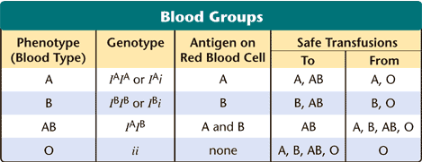
4 Blood type is an example of what type of inheritance?
Multiple Alleles
How many phenotypes are there? 4
How many genotypes are there? 6
3 Points (1 point each)

Slide 8
5. Fingerprints are an example of what type of inheritance? Incomplete Dominance
How many phenotypes are there? 3
How many genotypes are there? 3
ll Ll LL
3 Points (1 point each)

Slide 9
6. Why does it make sense that only 5% of the population has the arch pattern fingerprint? Explain
The arch pattern is homozygous recessive. You need two recessive alleles to have arch pattern.
Why is the Whorl fingerprint pattern so prevalent (common)? (Use Mendel’s Principle of Dominance to explain) It is the dominant allele (form) of the gene
4 Points (2 points each)

Slide 10
7. What other information would you want if you are the attorney trying to convict and/or defend this suspect? Why would you want this information? (List at least three and explain why)
Interview with suspects
Check suspects for recent injuries
DNA sample
Check fingerprints of people frequently touching case
Evidence that blood and fingerprint came from same person?
The probability of having each blood type
Are there any other possible suspects?
3 Points (1 point each)

Slide 11
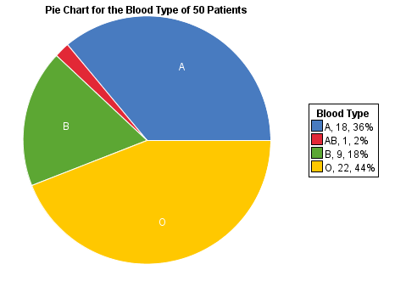
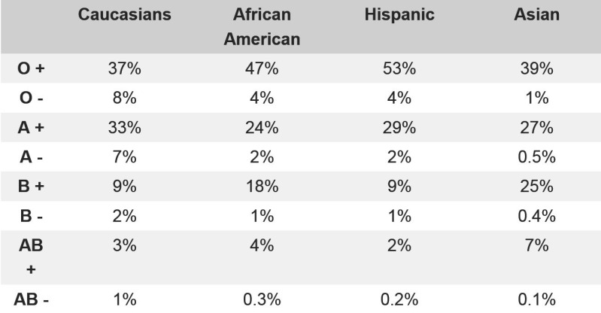

Slide 12
CER (Claim/Evidence/Reasoning)
Number 1
Claim: | Suspect #10
Evidence: | Blood type, Rh factor and fingerprint match
Reasoning: | Answers will vary
Number 2
Claim: | Suspect #1
Evidence: | Match blood type & fingerprint, but not Rh factor
Reasoning: | Answers will vary
Number 3
Claim: | Suspect #9
Evidence: | Blood type, Rh factor and fingerprint match
Reasoning: | Answers will vary
Number 4
Claim: | Suspect #3
Evidence: | Blood type and Rh factor match, but not fingerprint
Reasoning: | Answers will vary
Number 5
Claim: | Suspect #2
Evidence: | Blood type, Rh factor and fingerprint match
Reasoning: | Answers will vary
Number 6
Claim: | Suspect #8
Evidence: | Blood type, Rh factor and fingerprint match
Reasoning: | Answers will vary
18 Points (6 points each)

Slide 13
Total Points = 59

