Slide 1
GRADING RUBRIC
Lab: Epigenetics
HONORS BIOLOGY: UNIT 7

Slide 2
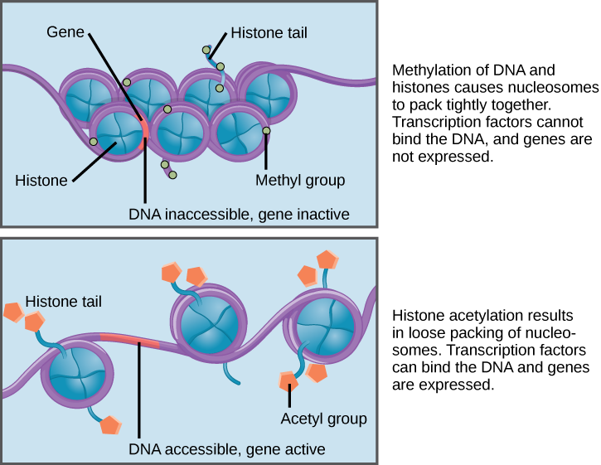
THE EPIGENOME AT A GLANCE
1. What is the epigenome?
It is a “second layer” of structure of DNA- the histones and chemical tags causes genes to be turned on or off. Epigenome reacts to outside signals (i.e. stress, diet)
2 points

Slide 3
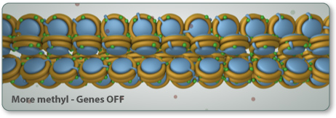
2. How is this different from your genome?
The epigenome influences (controls) the genome. The epigenome can change during your lifetime.
2 points

Slide 4
GENE CONTROL
1. Describe the following characteristics when a gene is active:
a. Is the gene tightly or loosely wound around histones? Loosely
b. Are there many or few methyl molecules attached to the gene? Few
c. Are there many or few acetyl molecules attached to the genes associated histones? Many
d. Are there many or few mRNA transcripts? Many
4 points

Slide 5
2. Describe the following characteristics when a gene is inactive:
a. Is the gene tightly or loosely wound around histones? Tightly
b. Are there many or few methyl molecules attached to the gene? Many
c. Are there many or few acetyl molecules attached to the genes associated histones? Few
d. Are there many or few mRNA transcripts? Few
4 points

Slide 6
3. How does epigenetics apply to cancer cells?
Cancer cells have a lower level of methylation (more active DNA) than healthy cells. Too little methylation causes:
•Activation of genes that promote cell growth.
•Chromosome instability: highly active DNA is more likely to be duplicated, deleted, and moved to other locations.
•Loss of imprinting
2 points

Slide 7
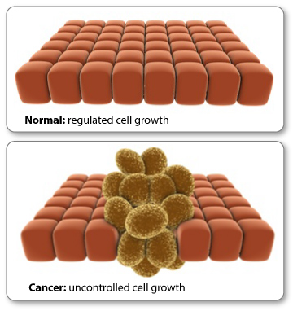
4. How could this information be used in cancer treatments?
Researchers are exploring drug therapies that can change the epigenetic profiles of cancer cells. (change the rate of cell growth and division)
2 points

Slide 8
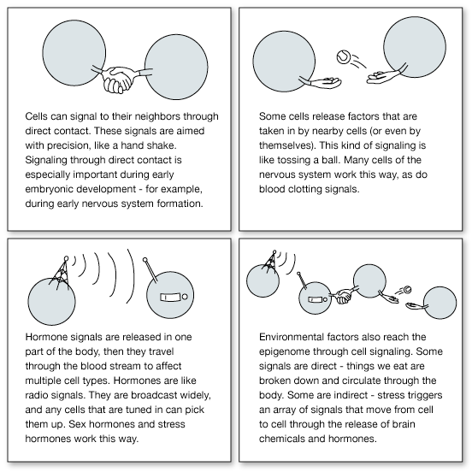
THE EPIGENOME LEARNS FROM ITS EXPERIENCES
1. True or False. Cell signals play a role in shaping gene expression only during development.
False.
A flexible epigenome allows us to adjust to changes in the world around us, and to “learn” from our experiences.
2 points

Slide 9
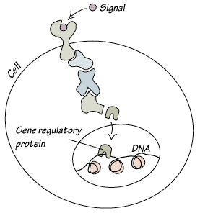
2. What molecule is primarily responsible for carrying cell signals to DNA?
Once a signal reaches a cell, proteins carry information inside. The information is ultimately passed to a gene regulatory protein that attaches to a specific sequence of letters on the DNA.
2 points

Slide 10
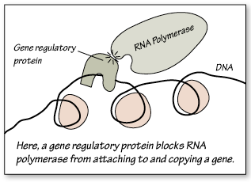
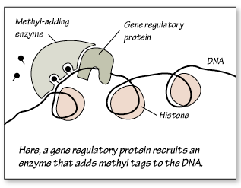
3. What are the two functions of gene regulatory proteins?
SWITCH SPECIFIC GENES ON OR OFF
2. RECRUIT ENZYMES THAT ADD AND REMOVE EPIGENETIC TAGS
2 points

Slide 11
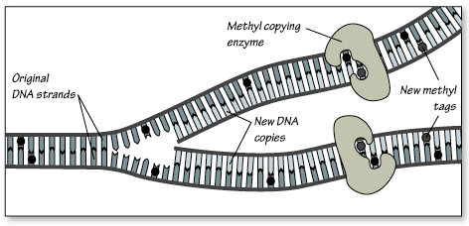
4. Are epigenetic tags passed to daughter cells?
YES. As cells grow and divide, cellular machinery faithfully copies epigenetic tags along with the DNA.
2 points

Slide 12
EPIGENETICS & INHERITANCE
1. What can be passed on to offspring besides just the DNA code?
Some epigenetic tags remain in place as genetic information passes from generation to generation, a process called epigenetic inheritance.
It means that a parent's experiences, in the form of epigenetic tags, can be passed down to future generations.
2 points

Slide 13
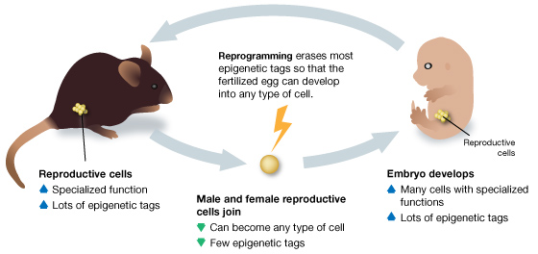
2. How does “reprogramming” work?
At certain times during development, specialized cellular machinery scours the genome and erases its epigenetic tags in order to return the cells to a genetic "blank slate." Yet, for a small minority of genes, epigenetic tags make it through this process and pass unchanged from parent to offspring.
2 points

Slide 14
3. How does this apply to epigenetics?
Reprogramming resets the epigenome of the early embryo so that it can form every type of cell in the body.
In order to pass to the next generation, epigenetic tags must avoid being erased during reprogramming.
2 points

Slide 15
4. Describe two examples of epigenetic inheritance. Include one human and one non-human example.
1. Gestational diabetes: Hormone-triggered type of diabetes during pregnancy. When the mother has gestational diabetes, the developing fetus is exposed to high levels of the sugar glucose. High glucose levels trigger epigenetic changes in the daughter's DNA, increasing the likelihood that she will develop gestational diabetes herself.
2 points

Slide 16
2. Nurturing behavior in rats: Rat pups who receive high or low nurturing from their mothers develop epigenetic differences that affect their response to stress later in life.
When the female pups become mothers themselves, the ones that received high quality care become high nurturing mothers. And the ones that received low quality care become low nurturing mothers.
2 points

Slide 17
5. How can epigenetics affect evolution?
The genome changes slowly, through the processes of random mutation and natural selection. It takes many generations for a genetic trait to become common in a population.
The epigenome, on the other hand, can change rapidly in response to signals from the environment.
Epigenetic inheritance may allow an organism to continually adjust its gene expression to fit its environment - without changing its DNA code.
2 points

Slide 18
IDENTICAL TWINS: PINPOINTING ENVIRONMENTAL IMPACT ON THE EPIGENOME
1. Often, the physical characteristics of genetically identical twins become increasingly different as they age, even at the molecular level. Explain why this is so. (use the terms "environment" and "epigenome")
Twins share the same genes but their environments become more different as they age.
This causes each of the epigenomes to react differently and change the regulation of specific genes over time.
2 points

Slide 19
2. Name 3-4 environmental factors that influence the epigenome.
Diet
Differences in physical activity
Exposure to toxins
Stress
2 points

Slide 20
3. What is an imprinted gene?
A inherited gene that has maintained its epigenetic tags (they were not reprogramed/erased)
2 points

Slide 21
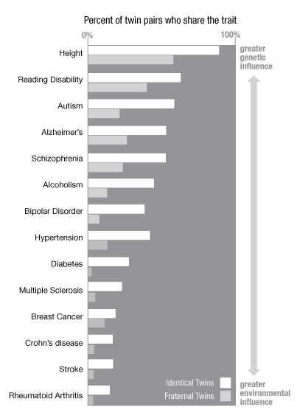
4. With the environment affecting the epigenome so much, how do scientists study how the environment and genes interact?
For example, when just one twin gets a disease, researchers can look for elements in the twins' environments that are different.
Or when both twins get a disease, researchers can look for genetic elements shared among similar twin pairs.
2 points

Slide 22
LICK YOUR RATS
1. Explain how a high-nurturing mother rat shapes her pup's epigenome, and what that pup's response to stress will be.
The nurturing behavior of a mother rat during the first week of life shapes her pups' epigenomes.
And the epigenetic pattern that mom establishes tends to stay put, even after the pups become adults.
The mothers nurturing can activate the GR gene (unwinds the DNA so the gene is active) so that the pup has an easier time relaxing after stress.
2 points

Slide 23
2. In rats, does licking by the mother activate, or deactivate her pup's GR gene?
It activates the GR gene
2 points

Slide 24
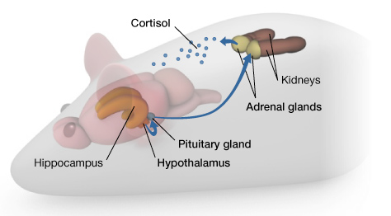
3. Explain how cortisol and the GR protein work together in the brain to relax a rat pup. You may draw a diagram.
Stress signals travel from the hypothalamus to the pituitary gland and then to the adrenal glands. The adrenal glands release the hormone cortisol (and adrenaline, not shown).
When cells in the hippocampus detect cortisol, which binds to the GR receptor, they send a signal to the hypothalamus that shuts down the stress circuit.
2 points

Slide 25
4. The rat nurturing example shows us how parental behavior can shape the behavior of their offspring on a biochemical level. Relate this to humans and think about the personal and social implications. Record your thoughts.
Answers will vary
Perhaps the same nurturing behavior effects humans as well.
It may also determine what kind of parents we become.
Rats (and people) with higher levels of GR are better at detecting cortisol, and they recover from stress more quickly.
2 points

Slide 26
NUTRITION & THE EPIGENOME
1. Explain how the food we eat affects gene expression.
Familiar nutrients like folic acid, B vitamins, and SAM-e (S-Adenosyl methionine, a popular over-the-counter supplement) are key components of this methyl-making pathway.
Diets high in these methyl-donating nutrients can rapidly alter gene expression, especially during early development when the epigenome is first being established.
2 points

Slide 27
2. How can the diets of parents (include BOTH parents!) affect their offspring's epigenome?
Your mother's diet during pregnancy and your diet as an infant can affect your epigenome in ways that stick with you into adulthood.
These records showed that food availability between the ages of nine and twelve for the paternal grandfather affected the lifespan of his grandchildren.
Shortage of food for the grandfather was associated with extended lifespan of his grandchildren.
Food abundance, on the other hand, was associated with a greatly shortened lifespan of the grandchildren.
2 points

Slide 28
EPIGENETICS & THE HUMAN BRAIN
1. Describe at least 2 connections between epigenetics and human behavior.
People who commit suicide have less-active ribosomal RNA (rRNA) genes than people who die of other causes.
Child abuse is an environmental factor that leaves an epigenetic mark on the brain. In a comparison of suicide victims who were abused or not, only the abused victims had an epigenetic tag on the GR gene.
Interestingly, the GR gene receives a similar epigenetic tag in rat pups who receive low quality care from their mothers.
2 points

Slide 29
2. Are there any social implications we need to be aware of as we learn more and more about what affects human behavior? If so, what kinds?
Drugs of abuse such as cocaine trigger epigenetic changes in certain brain regions, affecting hundreds of genes at a time. Some of these changes remain long after the drug has been cleared from the system.
Some drugs that are used to treat mental illness work by changing gene expression.
These changes in gene expression are stabilized through epigenetic mechanisms (DNA methylation and histone modification), reversing the effects of the disease.
2 points

Slide 30
TOTAL POINTS = 60

