Slide 1
Lab: DNA Fingerprinting
BIOLOGY: UNIT 7
GRADING RUBRIC

Slide 2
1. Case 1
A young woman claimed that her son was born as the result of an extra-marital affair with a famous athlete who was a multimillionaire. The athlete denied paternity, so the woman took her case to court, and sued for an extremely generous child support payment. The three individuals gave blood samples for DNA analysis, and the fingerprints are shown in Group 1 of Figure III.
Q1. Was the woman's claim justified?
NO

Slide 3
2. Case 2
The fingerprints of Group 2 of FIGURE III are from a Guatemalan family. A woman claimed that her daughter was born in Canada and emigrated to Guatemala to join her father. When she wanted to return to Canada, the immigration authorities claimed that she was not the woman's real daughter.
Q2. On the basis of the evidence is the woman's claim true?
YES

Slide 4
PART IV - DNA IN THE COURTROOM
Jimmy Solo. a famous rock star, returned to his remote upstate New York mansion from an appearance in Toronto. As Jimmy entered the side entrance he noticed a great mess in the living room and den. Drawers had been emptied ; couch cushions ripped open; the furniture was in disarray and the wall safe in the study was open. He stormed upstairs to see if his expensive jewelry collection had been touched and upon doing so heard someone in his bedroom. He grabbed a small metal statue and rushed into his bedroom surprising the thief. In the ensuing struggle the thief's gun discharged killing Jimmy instantly. The next day the housekeeper found Jimmy dead on the floor and immediately contacted the police. The subsequent investigation identified seven possible suspects. They were:
1. Willie James - lead guitarist in Jimmy's band who was constantly upstaged and underpaid by Jimmy.
2. Samantha Smith - Jimmy's former girlfriend who was dropped by him following three years of cohabitation..
3. Lucifer - Jimmy's bodyguard who is extremely jealous of Jimmy's wealth.
4. Jamie Waite - Jimmy's manager who has accumulated massive gambling debts.
5. Dicky Schultz - a former acquaintance of Jimmy's who claims he is owed thousands for past services.
6. Casparina - Jimmy's new girlfriend who is under pressure from former friends to pay back large loans.
7. Jimmy The Weasel - a former friend of Jimmy who was promised a position in Jimmy's band that never materialized.

Slide 5
It was established that all had a motive for killing Jimmy and none had an ironclad alibi. The police
realized they had a problem and consequently decided to undertake a DNA fingerprinting of all suspects and from a blood sample taken from the crime scene.
Q3. Using the DNA fingerprint in Figure IV on the evidence sheet, determine who killed Jimmy solo. Who was it?
3. Lucifer - Jimmy's bodyguard who is extremely jealous of Jimmy's wealth.

Slide 6
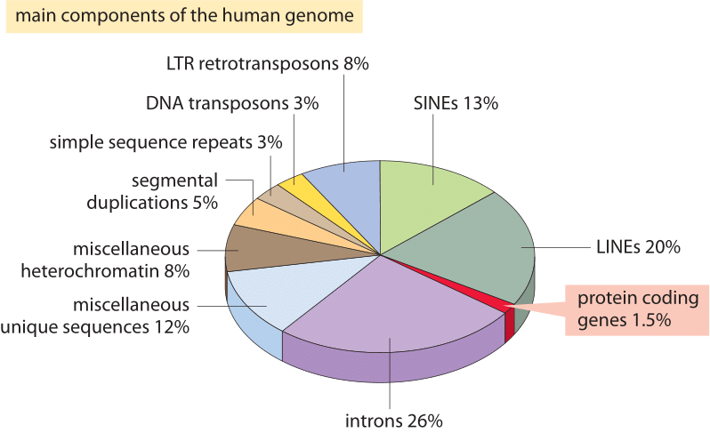
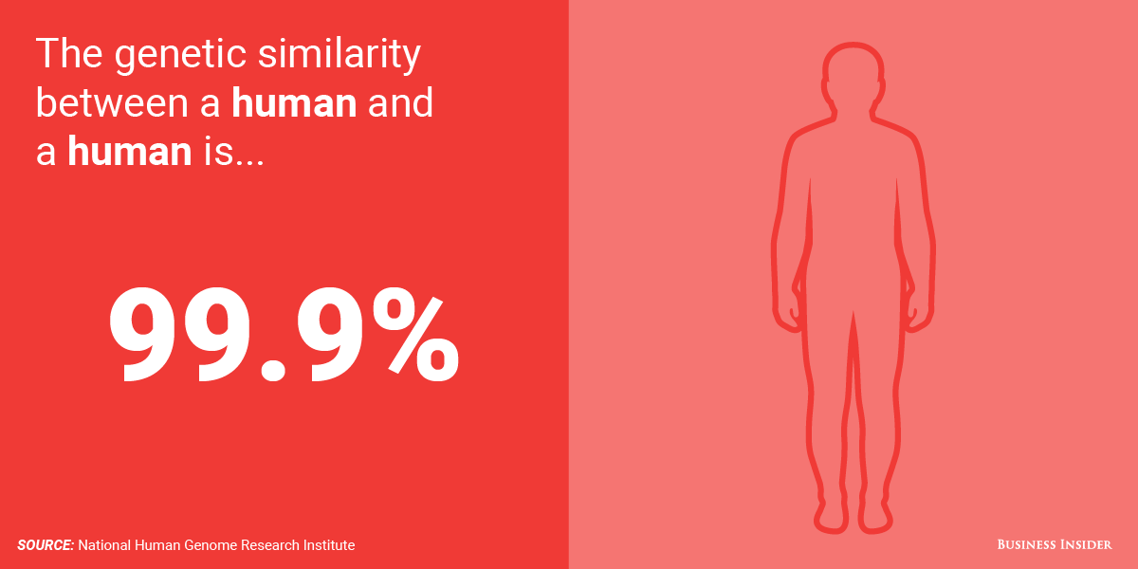
CONCLUSION QUESTIONS:
1. If all humans share 95.5% or more of their DNA, how can a DNA fingerprint differentiate between to individuals?
Hypervariable regions of DNA are used

Slide 7
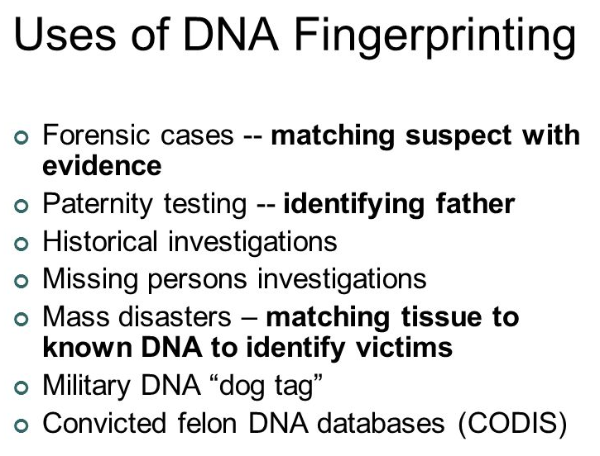
2. What are DNA fingerprints currently used for?

