Slide 1
BIOLOGY
GRADING RUBRIC:
Worksheet: Chapter 3 Review

Slide 2
1. Describe how the following scientists contributed to the development of the Cell Theory (5 pts.)
a. Robert Hooke- Used compound microscope to look at cork cells. Gave name “cells”

Slide 3
1. Describe how the following scientists contributed to the development of the Cell Theory (5 pts.)
b. Anton van Leeuwenhoek-made powerful single lens microscope. One of first to look at anddescribe living cells

Slide 4
1. Describe how the following scientists contributed to the development of the Cell Theory (5 pts.)
c. Matthias Schleiden-proposed all plants made of cells

Slide 5
1. Describe how the following scientists contributed to the development of the Cell Theory (5 pts.)
d. Theordor Schwann-after talking with Schleiden, concluded that all animals were also composed of cells

Slide 6
1. Describe how the following scientists contributed to the development of the Cell Theory (5 pts.)
e. Rudolf Virchow-Proposed that all cells come from pre-existing cells

Slide 7
2. List the three (3) major principles of the Cell Theory (3 pts.)
a. All organisms are made of cells
b. All existing cells are produced by other living cells
c. The cell is the most basic unit of life

Slide 8
3. Complete the chart below describing the similarities and differences between Eukaryotic and Prokaryotic cells- answer either yes or no. (7 pts.)
Contains | Prokaryotic Cells | Eukaryotic Cells
Has nucleus | No | Yes
Has membrane-bound organelles | No | Yes
Has cytoplasm | Yes | Yes
Can be multicellular | No | Yes
Considered a “living” thing | Yes | Yes
Has a cell wall | Yes | Some do
Contains genetic material | Yes | Yes

Slide 9
4. Complete the chart below comparing plant and animal cells –answer either yes or no (9 pts.)
Contains | Animal cells | Plant cells
Nucleus | Yes | Yes
Cell wall | No | Yes
Cell membrane | Yes | Yes
Mitochondria | Yes | Yes
Chloroplasts | No | Yes
Ribosomes | Yes | Yes
Large central vacuole | No | Yes
Centrioles | Yes | No
Lysosomes | Yes | No

Slide 10
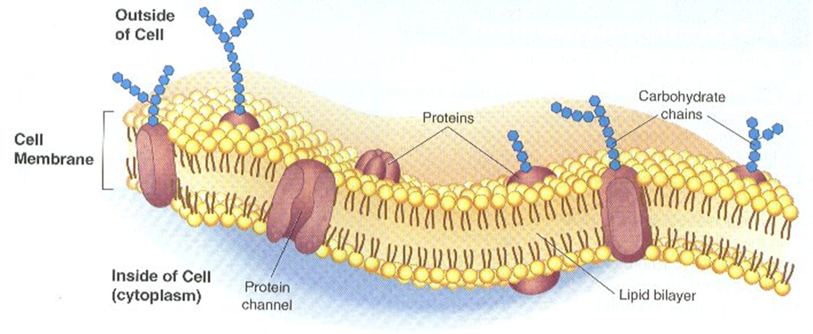
5. Draw and label a diagram of a typical cell membrane. Identify the following structures: lipid bilayer (phospholipids), protein channels, carbohydrate chain (6 pts.)

Slide 11
6. Describe what is happening in Figure 3.23 on page 86 (3 pts.)
a. Isotonic solution-same concentration of dissolved materials (water moves in and out at equal rate)
b. Hypertonic solution-solution has higher concentration of dissolved materials (Water concentration higher in cell than outside- water moves out of cell
c. Hypotonic solution-Solution has lower concentration of dissolved materials (water moves into the cell)

Slide 12
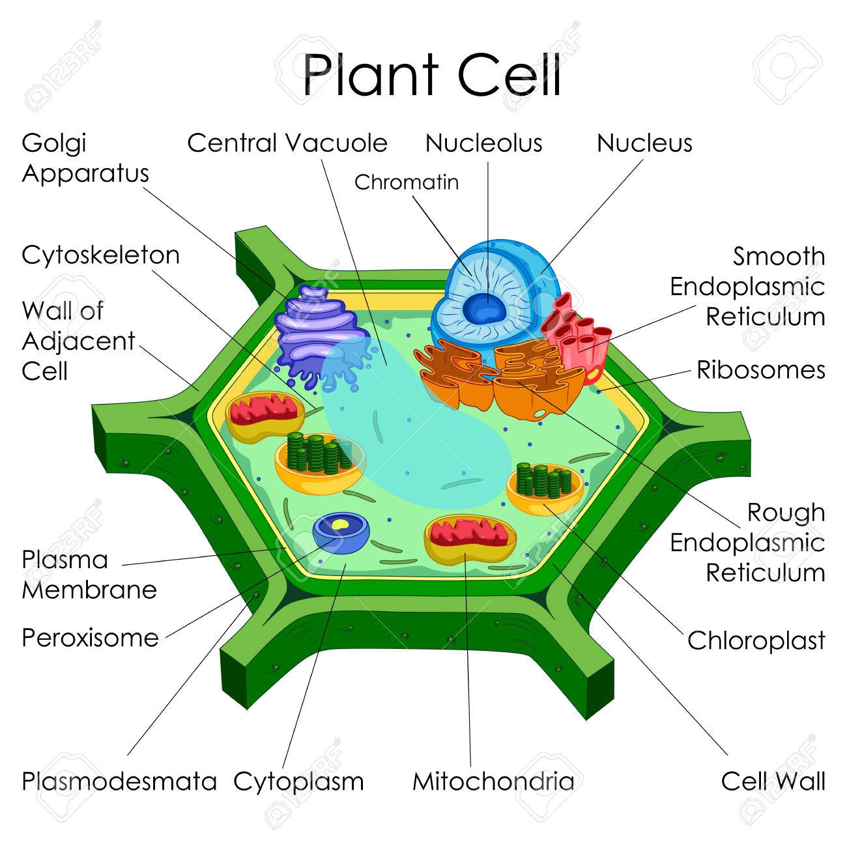
7. Draw and label a typical plant cell.

Slide 13
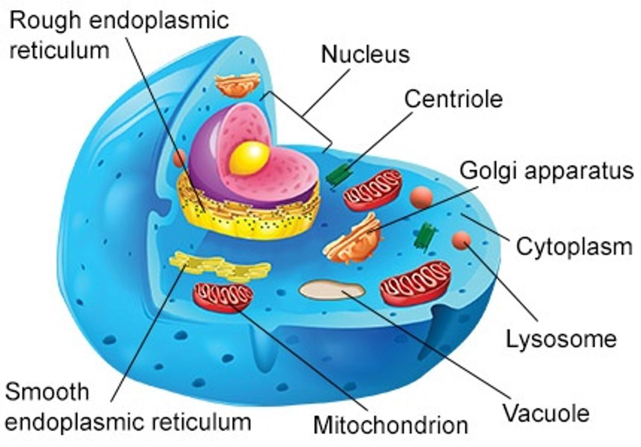
8. Draw and label a typical animal cell.

