Slide 1
SPRING FINAL EXAM REVIEW

Slide 2
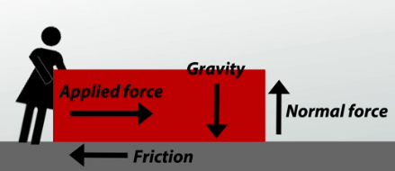
Define the following terms:
Force- Any push or pull on an object
b. Net Force- The sum of forces acting on an object
c. Friction- A force that act in the opposite direction of a force (e.g. air resistance)
d. Average speed- The total distance divided by the total time

Slide 3
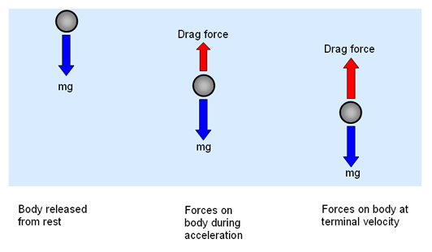
e. Instantaneous speed- The speed you are traveling at that moment (instant). E.g. car speedometer
f. Acceleration- a change in velocity over time
g. Vector- a quantity that has both magnitude and direction. Described using an arrow.
h. Terminal velocity- The maximum velocity a falling object can obtain. When Force of gravity and air resistance forces are equal and opposite in direction.

Slide 4
i. Newton’s First Law- sometimes referred to as the law of inertia. An object at rest stays at rest and an object in motion stays in motion with the same speed and in the same direction unless acted upon by an unbalanced force.
j. Newton’s Second Law- The acceleration of an object as produced by a net force is directly proportional to the magnitude of the net force, in the same direction as the net force, and inversely proportional to the mass of the object. $F=ma$
k. Newton’s Third Law- For every action, there is an equal and opposite reaction
l. Electromagnetic spectrum-

Slide 5
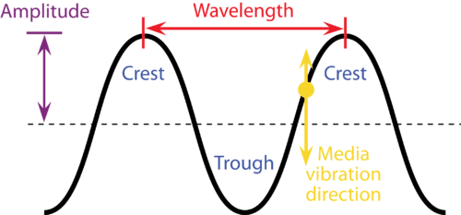
m. Transverse wave- a wave vibrating at right angles to the direction of its propagation. (e.g. electromagnetic waves)
n. Longitudinal wave- a wave vibrating in the direction of propagation. (e.g. sound waves)

Slide 6
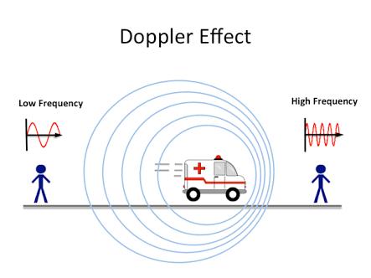
o. Doppler Effect- an increase (or decrease) in the frequency of sound, light, or other waves as the source and observer move toward (or away from) each other.
p. Mass- the quantity of matter in a body regardless of its volume or of any forces acting on it. (mass is not the same as weight) measured in kilograms (kg)

Slide 7
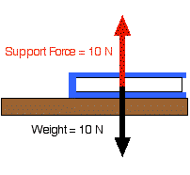
q. Weight (force of gravity)-
r. Equilibrium- If the size and direction of the forces acting on an object are exactly balanced, then there is no net force acting on it
F_{N} = 0 Newtons

Slide 8
What are the units for the following?
Force- Newtons (N)
b. Speed and velocity- Meters/second (m/s)
c. Distance- Meters (m)
d. Time- Seconds (s)
e. Acceleration- Meters/seconds squared (m/s²)

Slide 9
f. Mass- Kilograms (kg)
g. Weight (Force of gravity)- Newtons (N)
h. Momentum- Kilograms X meters per seconds (kg × m/s)
i. Kinetic energy- Joules (J)
j. Potential energy- Joules (J)
k. Work- Joules (J)
l. Current-Amperes (amps) (A)

Slide 10
m. Voltage- Volts (V)
n. Resistance- Ohms (Ω )
o. Power- Watts ($W)$
p. Wavelength- ($γ$)
q. Frequency- (f)
r. Wave speed- Meters/second (m/s)

Slide 11
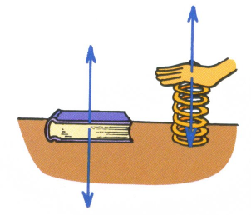
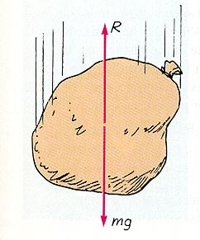
PART 3: PHYSICS CONCEPTS 1. Identify two situations in which an object can have a net force = 0 Newtons. Draw the Free Body
Diagrams that go with both scenarios.
A falling object whose Force of gravity is equal to the air resistance force
An object at rest on a table
+10N
+10N
F_{N} = 0N
-10N
F_{N} = 0N
-10N

Slide 12
2. What is meant by “free fall”?
A falling object where the only force acting on it is gravity (we assume there is no air resistance)

Slide 13
3. Which of the following will remain constant when an object is falling and there is no air resistance? (circle all that apply)
Velocity
Speed
Acceleration
Both speed and velocity increase as an object falls

Slide 14
4. Explain what happens to both the kinetic and potential energies of an object when it is falling.
PE = 5000J
KE = 0J
It always totals 5000J
(The Law of Conservation of Energy
PE = 1000J
KE = 4000J
PE = 0J
KE = 5000J

Slide 15
5. Forces always occur in pairs.
6. An object will accelerate when it is affected by unbalanced net force.
7. In the absence of air resistance, the angle at which a thrown ball will go the farthest is 45°.
8. When an object reaches terminal velocity its acceleration equals zero.
9. All waves are created by vibrations.
10. In circuits of metal wires, electrons are the flowing charged particles.

Slide 16
12. Any path along which electrons can flow is called a electrical circuit.
13. In most waves, the speed of the wave only depends on the waves medium.
14. What is the “Law of Conservation of Energy”?
Energy can neither be created nor destroyed; rather, it can only be transformed from one form to another.

Slide 17
15. Friction is a force that always acts opposite to an object's motion.
16. A ball is thrown straight upward at 5 m/s. Ideally (no air resistance), the ball will return to the
thrower's hand with a speed of 5 m/s.
17. If a freely falling object were somehow equipped with a speedometer, its speed reading would increase each second by 10 m/s.
18. Touching a charged body to earth to eliminate excess charge is called grounding.

Slide 18
20. According to Coulomb’s law, as the magnitude of charge increases, the amount of force will increase.
21. Describe why a 0.001 kg feather falling at 1 m/s has more momentum than a 100,000,000 kg boat at rest at a dock.
Momentum equals mass x velocity $p=mv$
If velocity is zero (0m/s) then momentum = zero

Slide 19
22. How would doubling the voltage in a circuit affect the current? What about doubling the resistance?
$I=\frac{V}{R}$
It doubles (voltage is directly proportional to current)
23. Imagine there is a circuit that has 3 light bulbs – would the brightness of the bulbs be greater if they are wired in parallel or series? Why?
Parallel. Because voltage is split between light bulbs in a series circuit

Slide 20
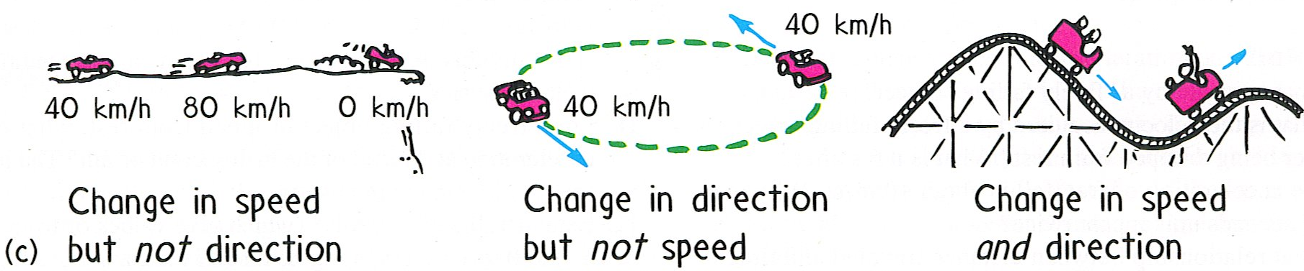
24. Is it better to wire holiday lights in parallel or series? Why? Parallel. Because if one light burns out in a series circuit all of the bulbs go out.
25. When talking about sound waves, what mean the same as frequency and amplitude?
Frequency = pitch
Amplitude= loudness
26. Describe a scenario when an object has constant speed but not constant velocity. A car driving at a constant speed in a circle (velocity is a vector quantity)

Slide 21
PART 4: WORD PROBLEMS: 1. A 40 -N falling object encounters 5-N of air resistance. The magnitude of the net force on the
object is? (Draw a diagram and use vectors to answer)
40N
F_{n} = 35N
If vectors are in opposite direction: subtract
If vectors in same direction: add
5N

Slide 22
2. A bike travels at a constant speed of 20 m/s for 2 seconds. How far did it travel?
v = 20 m/s
t = 2 s
d= ?
$$d=\left(20\right)\left(2\right)$$
$$d=vt$$
$$d=40 m$$

Slide 23
3. A bike travels at a constant speed of 100 meters in 10 seconds. What was the average speed?
t = 10s
d = 100m
v = ?
$$v=\frac{100}{10}$$
$$v=\frac{d}{t}$$
$$v=10m/s$$

Slide 24
4. How much time will it take for a person to walk 400 meters at a constant speed of 5 m/s?
t = ?
d = 400m
v = 5m/s
$$t=\frac{400}{5}$$
$$t=\frac{d}{v}$$
$$t=80s$$

Slide 25
5. You drop a rock off of a tall building. It hits the ground in 3.0 seconds. What is the final velocity?
t = 3.0s
g = 10m/s₂
v = ?
V₀ = m/s
$$v=0+\left(10\right)\left(3\right)$$
$$v=v_{0}+gt$$
$$v=30m/s$$

Slide 26
6. A ball is dropped from rest from a height 25.0 meters above the ground. The ball falls freely and reaches the ground 4.0 seconds later. What is the average speed of the ball
t = 4s
d = 25m
v = ?
$$v=\frac{25}{4}$$
$$v=\frac{d}{t}$$
$$v=6.25m/s$$

Slide 27
7. You drop a rock off of the top of a 50 m tall building. How long does it take before it hits the ground?
$$t=\sqrt{\frac{\left(2\right)\left(50\right)}{10}}$$
t = ?
d = 50m
g = 10m/s²
$$t=\sqrt{\frac{2d}{g}}$$
$$t=3.16s$$

Slide 28
8. The figure shows a block that is being pulled along the floor. According to the figure, what is the acceleration of the block?
m = 20kg
F_{N} = 100N
a = ?
$$a=\frac{100}{20}$$
$$a=\frac{F}{m}$$
$$a=5m/s^{2}$$

Slide 29
9. Suppose a small plane can fly at 200km/h relative to the surrounding air. Suppose also that there is a 50km/h tailwind. How fast does the plane's shadow move across the ground? (draw vectors to solve)
50km/h
200km/h
250km/h
If vectors in same direction: add
If vectors are in opposite direction: subtract

Slide 30
10. A car travels 5 meters in the first second of travel, 5 meters again during the second second of travel, and 5 meters again during the third second. Its acceleration is?
Velocity does not change over time:
Velocity 1st second = 5 m/s
Velocity 2nd second = 5 m/s
Velocity 3rd second = 5 m/s
d = 5m
t = 1s
a = ?
v = 5m/s
$$a=\frac{∆v}{t}$$
$$a=0\frac{m}{s^{2}}$$

Slide 31
11. You drop a rock off of a tall building. It takes 10 seconds to hit the ground. How tall is the building?
t = 10s
d = ?
g = 10m/s²
$$d=\frac{1}{2}\left(10\right){\left(10\right)}^{2}$$
$$d=\frac{1}{2}gt^{2}$$
$$d=500m$$

Slide 32
12. A truck has a mass of 1000 kg and accelerates at 2 meters per second squared. What is the magnitude of the force acting on the truck?
m = 1000kg
a = 2m/s²
F = ?
$$F=\left(1000\right)\left(2\right)$$
$$F=ma$$
$$F=500m$$

Slide 33
13. A tow truck exerts a force of 2000 N on a car, accelerating it a 1 m/s2. What is the mass of the car?
m = ?
a = 1m/s²
F = 2000N
$$m=\frac{2000}{1}$$
$$m=\frac{F}{a}$$
$$m=2000kg$$

Slide 34
14. A hydraulic lift used at an automotive repair shop raises a 500-kilogram car 3 meters off of the ground. What is the potential energy given to the car?
m = 500kg
h = 3m
PE = ?
$$PE=\left(500\right)\left(10\right)\left(3\right)$$
$$PE=15,000J$$
$$PE=mgh$$

Slide 35
15. A 3-kg brick falls to the ground from a 10-m-high roof. What is the approximate kinetic energy of the brick just before it touches the ground?
m = 3kg
h = 10m
KE = ?
$$PE=\left(3\right)\left(10\right)\left(10\right)$$
$$PE=15,000J$$
When the object falls the potential energy is transformed into kinetic energy
$$PE=mgh$$
$$KE=15,000J$$

Slide 36
16. What is the kinetic energy of a wagon with a mass of 2.5 kilograms traveling at a speed of 4 meters per second? Assume no other forces act upon the object.
$$KE=\frac{1}{2}\left(2.5\right)\left(4^{2}\right)$$
m = 2.5kg
v = 4m/s
KE = ?
$$KE=\frac{1}{2}mv^{2}$$
$$KE=20J$$

Slide 37
17. A sound wave traveling through a solid material has a frequency of 450 hertz. The wavelength of the sound wave is 1 meters. What is the speed of sound in the material?
f = 450Hz
Ƴ = 1m
v = ?
$$v=\left(1\right)\left(450\right)$$
$$v=450m/s$$
$$v=\text{γ}\text{f}$$

Slide 38
18. If 15 N of force are applies to a cart to move it a distance of 5 m, how much work is done on the cart?
F = 15N
d = 5m
W = ?
$$W=\left(15\right)\left(5\right)$$
$$W=Fd$$
$$W=75J$$

Slide 39
19. A sound wave has a frequency of 250 Hz and a wavelength measured at 2.00 m. What is the speed of the wave?
f = 250Hz
Ƴ = 2m
v = ?
$$v=\left(2\right)\left(250\right)$$
$$v=\text{γ}\text{f}$$
$$v=500m/s$$

Slide 40
20. An object has an initial Gravitational Potential Energy of 5000 J and its initial Kinetic Energy is 0 J. If it’s Gravitational Potential Energy after is 1000 J, what is its Kinetic Energy after?
PE = 5000J
KE = 0J
It always totals 5000J
(The Law of Conservation of Energy
PE = 1000J
KE = 4000J
PE = 0J
KE = 5000J

Slide 41
21. A child is on a sled moving down a hill at 15.0 m/s. The combined mass of the sled and child is 50.0 kilograms. The momentum of the child and sled is?
v = 15m/s
m = 50.0kg
p = ?
$$p=\left(50\right)\left(15\right)$$
$$p=75kg∙m/s$$
$$p=mv$$

Slide 42
22. A 100-watt light bulb is connected to a 120-V outlet. How much current is in the light bulb?
P = 100W
V = 120V
I = ?
$$I=\frac{100}{120}$$
$$I=0.83A$$
$$I=\frac{P}{V}$$

Slide 43
23. How much power is used by a 12 Volt battery that draws 2 A of current?
P = ?
V = 12V
I = 2A
$$P=\left(2\right)\left(12\right)$$
$$P=24W$$
$$P=IV$$

Slide 44
24. When a 12-V battery is connected to a resistor, 0.5 A of current flows in the resistor. What is the resistor's value?
R = ?
V = 12V
I = 0.5A
$$R=\frac{12}{0.5}$$
$$R=24ohms$$
$$R=\frac{V}{I}$$

Slide 45
25. A 20-ohm resistor has a 5-A current in it. What is the voltage across the resistor?
R = 20Ω
I = 5A
V = ?
$$V=\left(5\right)\left(20\right)$$
$$V=100V$$
$$V=IR$$

